Slide 1
Online Shopping System
Presented By
Group No : 91
Rajendra Kumar Sharma & Ripunjai Kaushik

Slide 2
Introduction
The primary goal of our Infant Immunization Management site is to sell vaccines online. In this application the customer can login, select products, quantity and proceed towards confirm order. After confirming the order Admin will get a notification of the order. Payment method will be online through payment Gateway. This website will give the Customer a greater exposure to their products at their Ease of Comfort. It provides the user with a catalogue of different product available for purchase in the store.

Slide 3
Technology Used
We used C# , ASP.NET as backend & HTML , CSS , JS , Jquery , AJAX , BootStrap5 as Frontend in our Project.
ASP.NET :–
ASP.NET is a web framework designed and developed by Microsoft. It is used to develop websites, web applications and web services. It provides fantastic integration of HTML, CSS and JavaScript.
ASP.NET is an open-source, server-side web-application framework designed for web development to produce dynamic web pages. It was developed by Microsoft to allow programmers to build dynamic web sites, applications and services. The name stands for Active Server Pages Network Enabled Technologies.

Slide 4


User Classes
User
Admin
In this module Admin can add or delete anything products.
In this module User will register and buy any product.

Slide 5
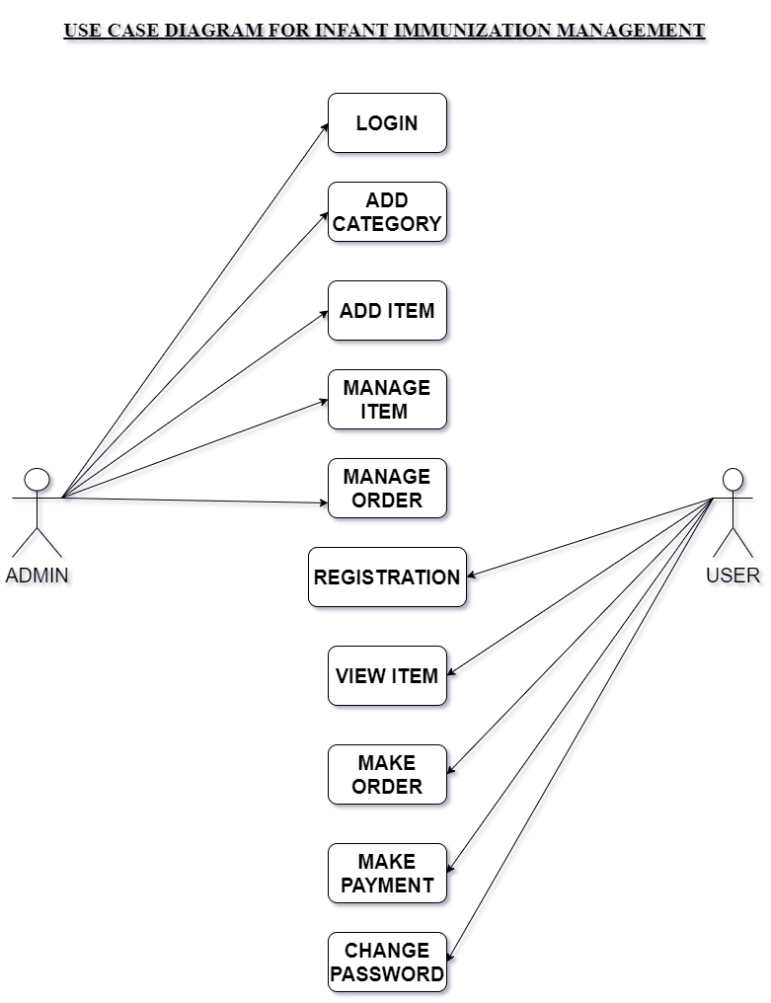
Use Case diagram for Users

Slide 6
Customer Module
After successful registration and authentication
The User can buy product.
User can add products in the cart.
Able to pay for the products they want to buy.

Slide 7
Manager Module
The Manager can
Add new Products.
Assign Delivery.
Delete products.
Edit products
View orders.

Slide 8
Delivery Module
The Delivery Man can
View all Orders
Pick Up Order
Deliver Order

Slide 9
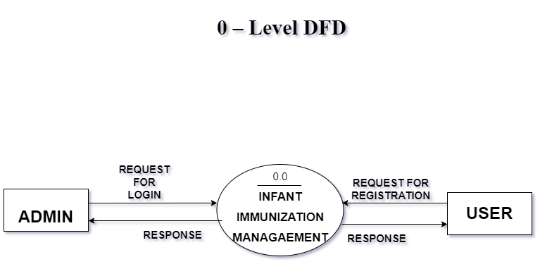
Activity Diagram :

Slide 10
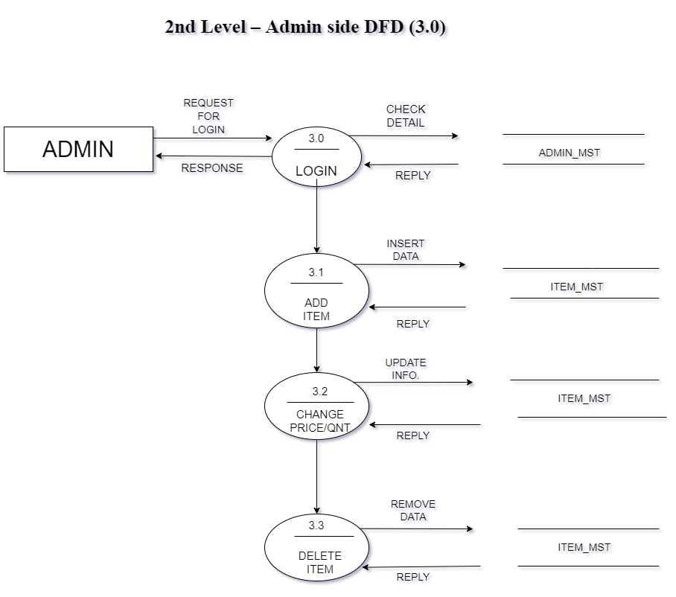
Activity Diagram :

Slide 11
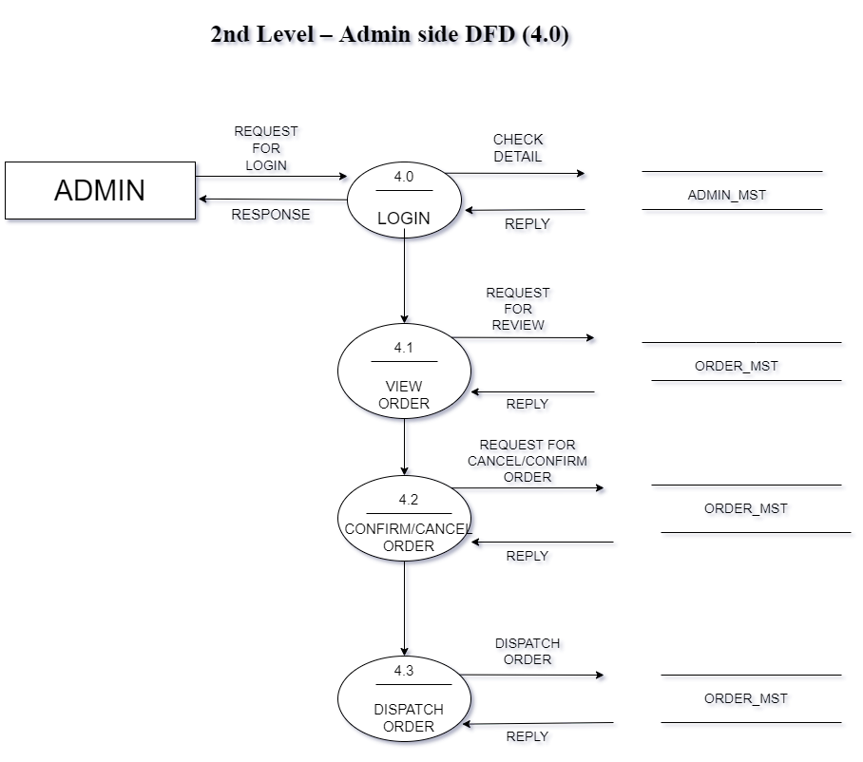
Activity Diagram :

Slide 12
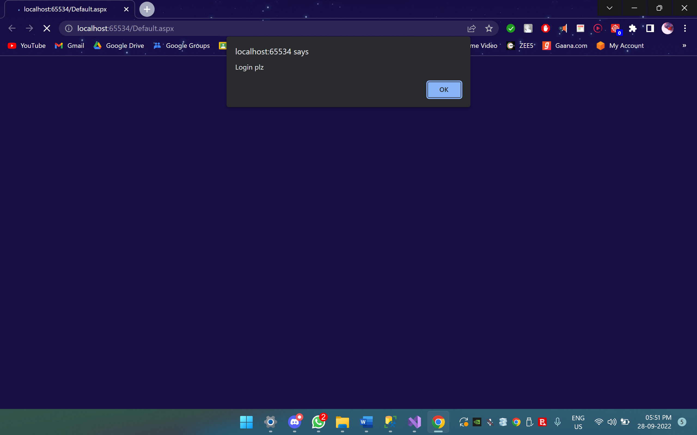

Slide 13
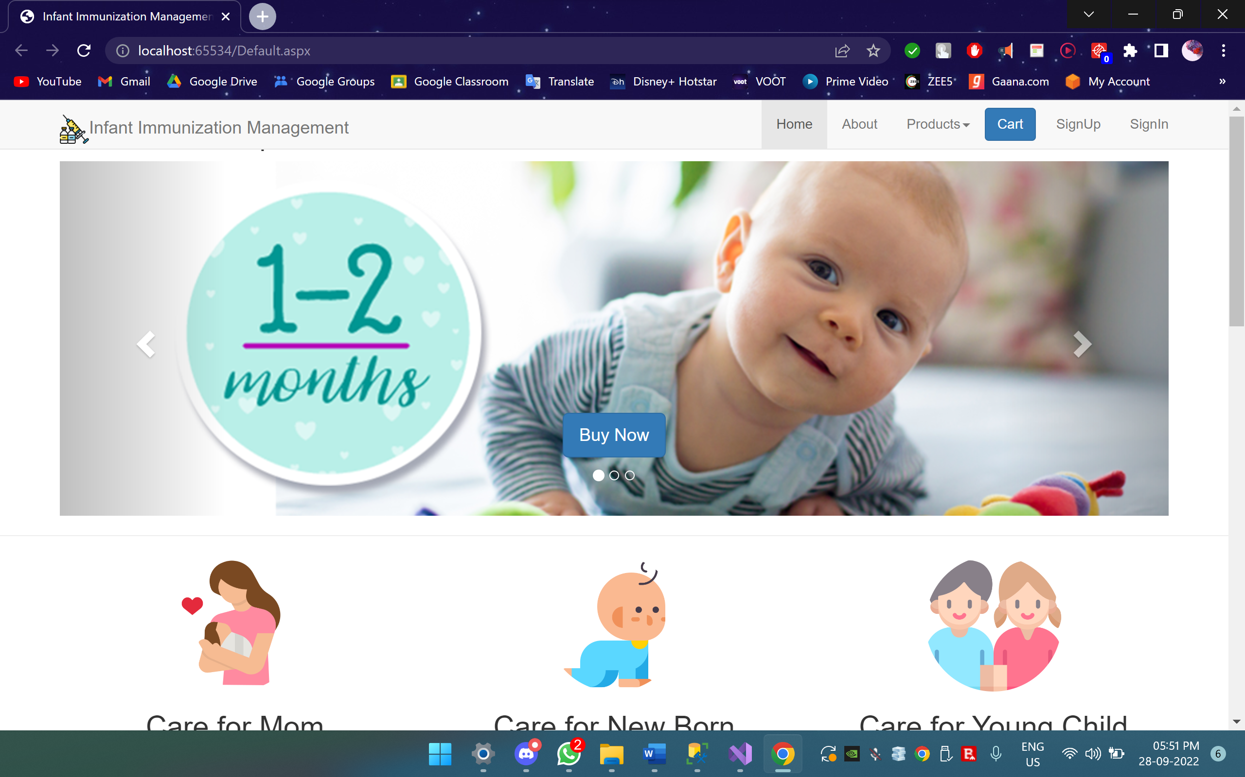

Slide 14
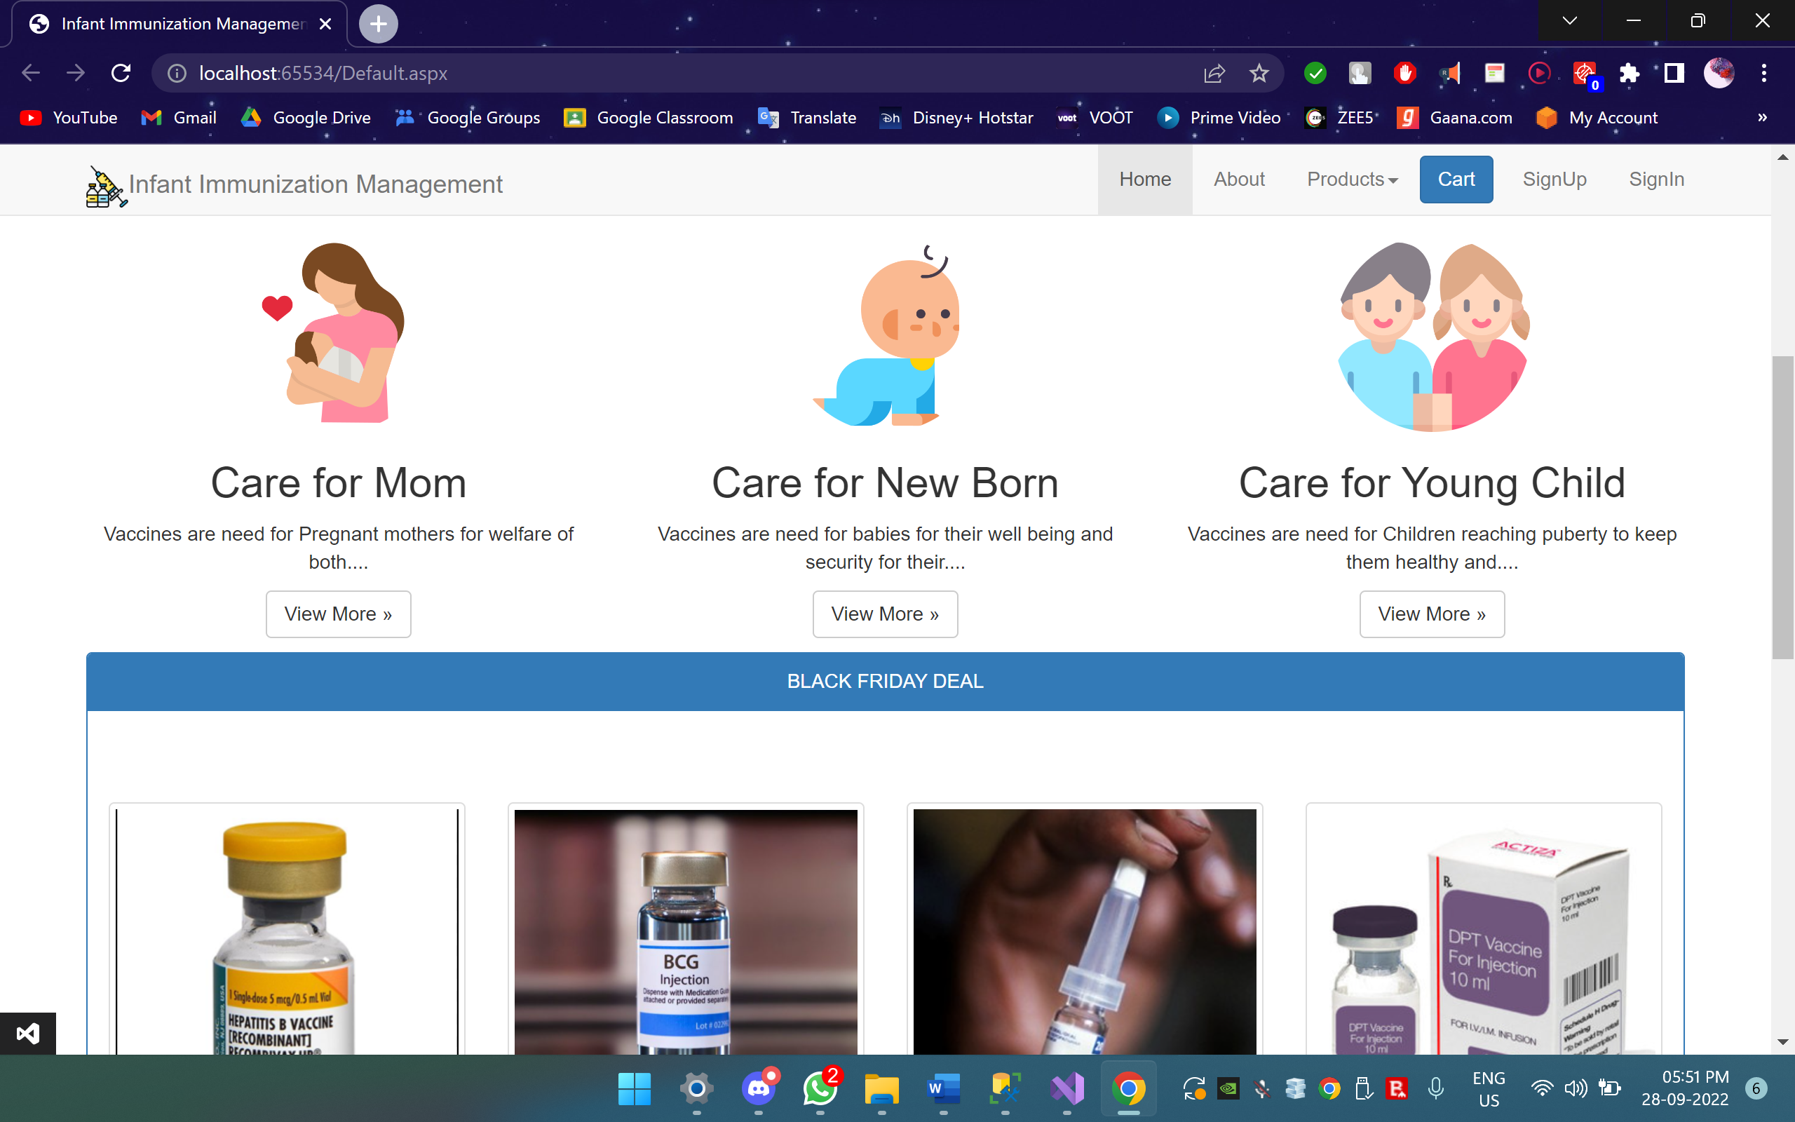

Slide 15
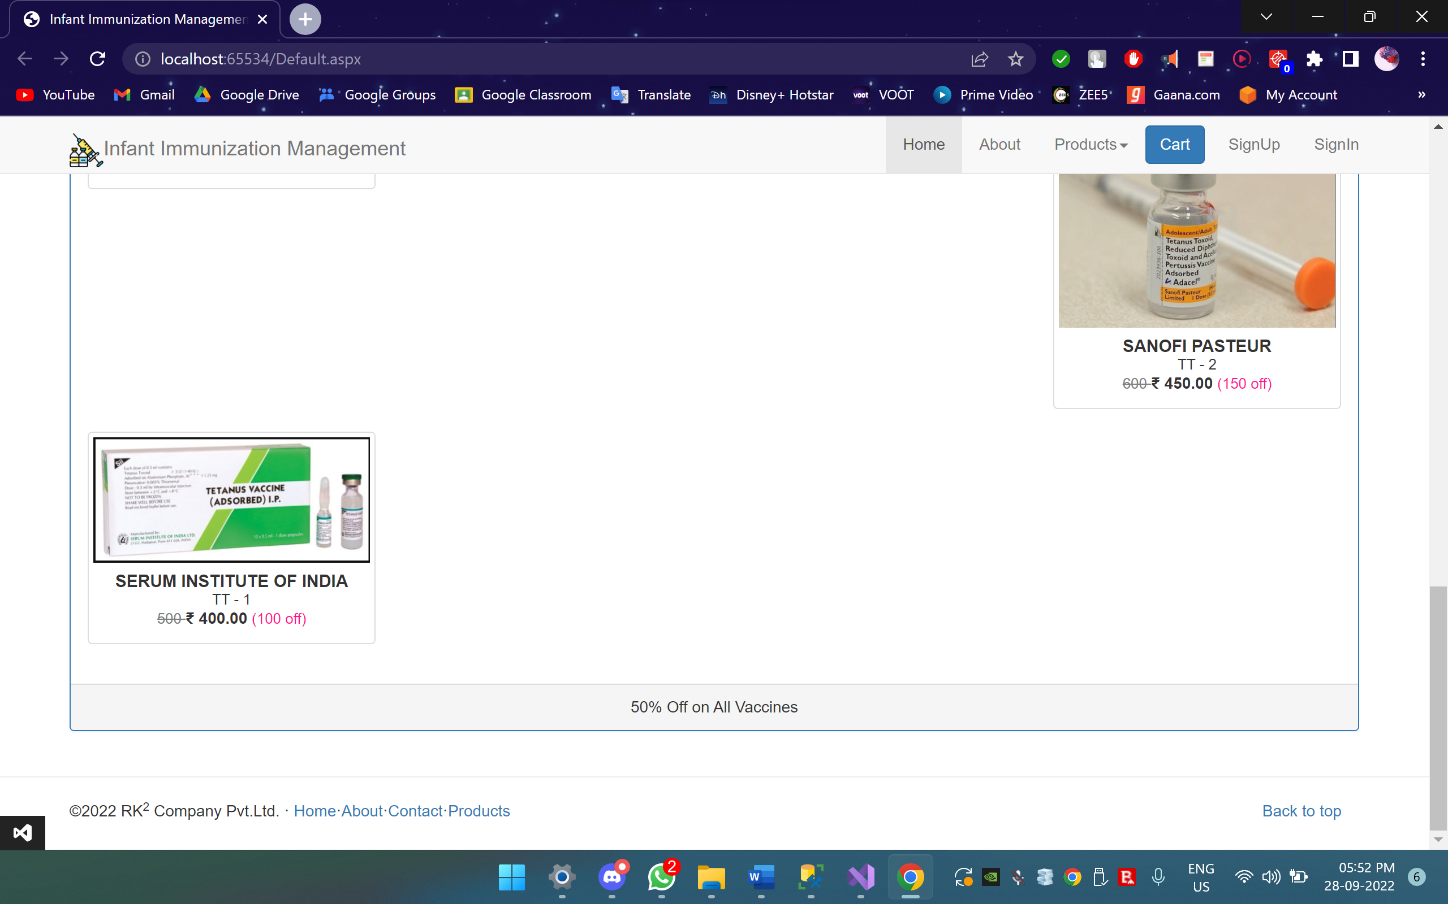

Slide 16
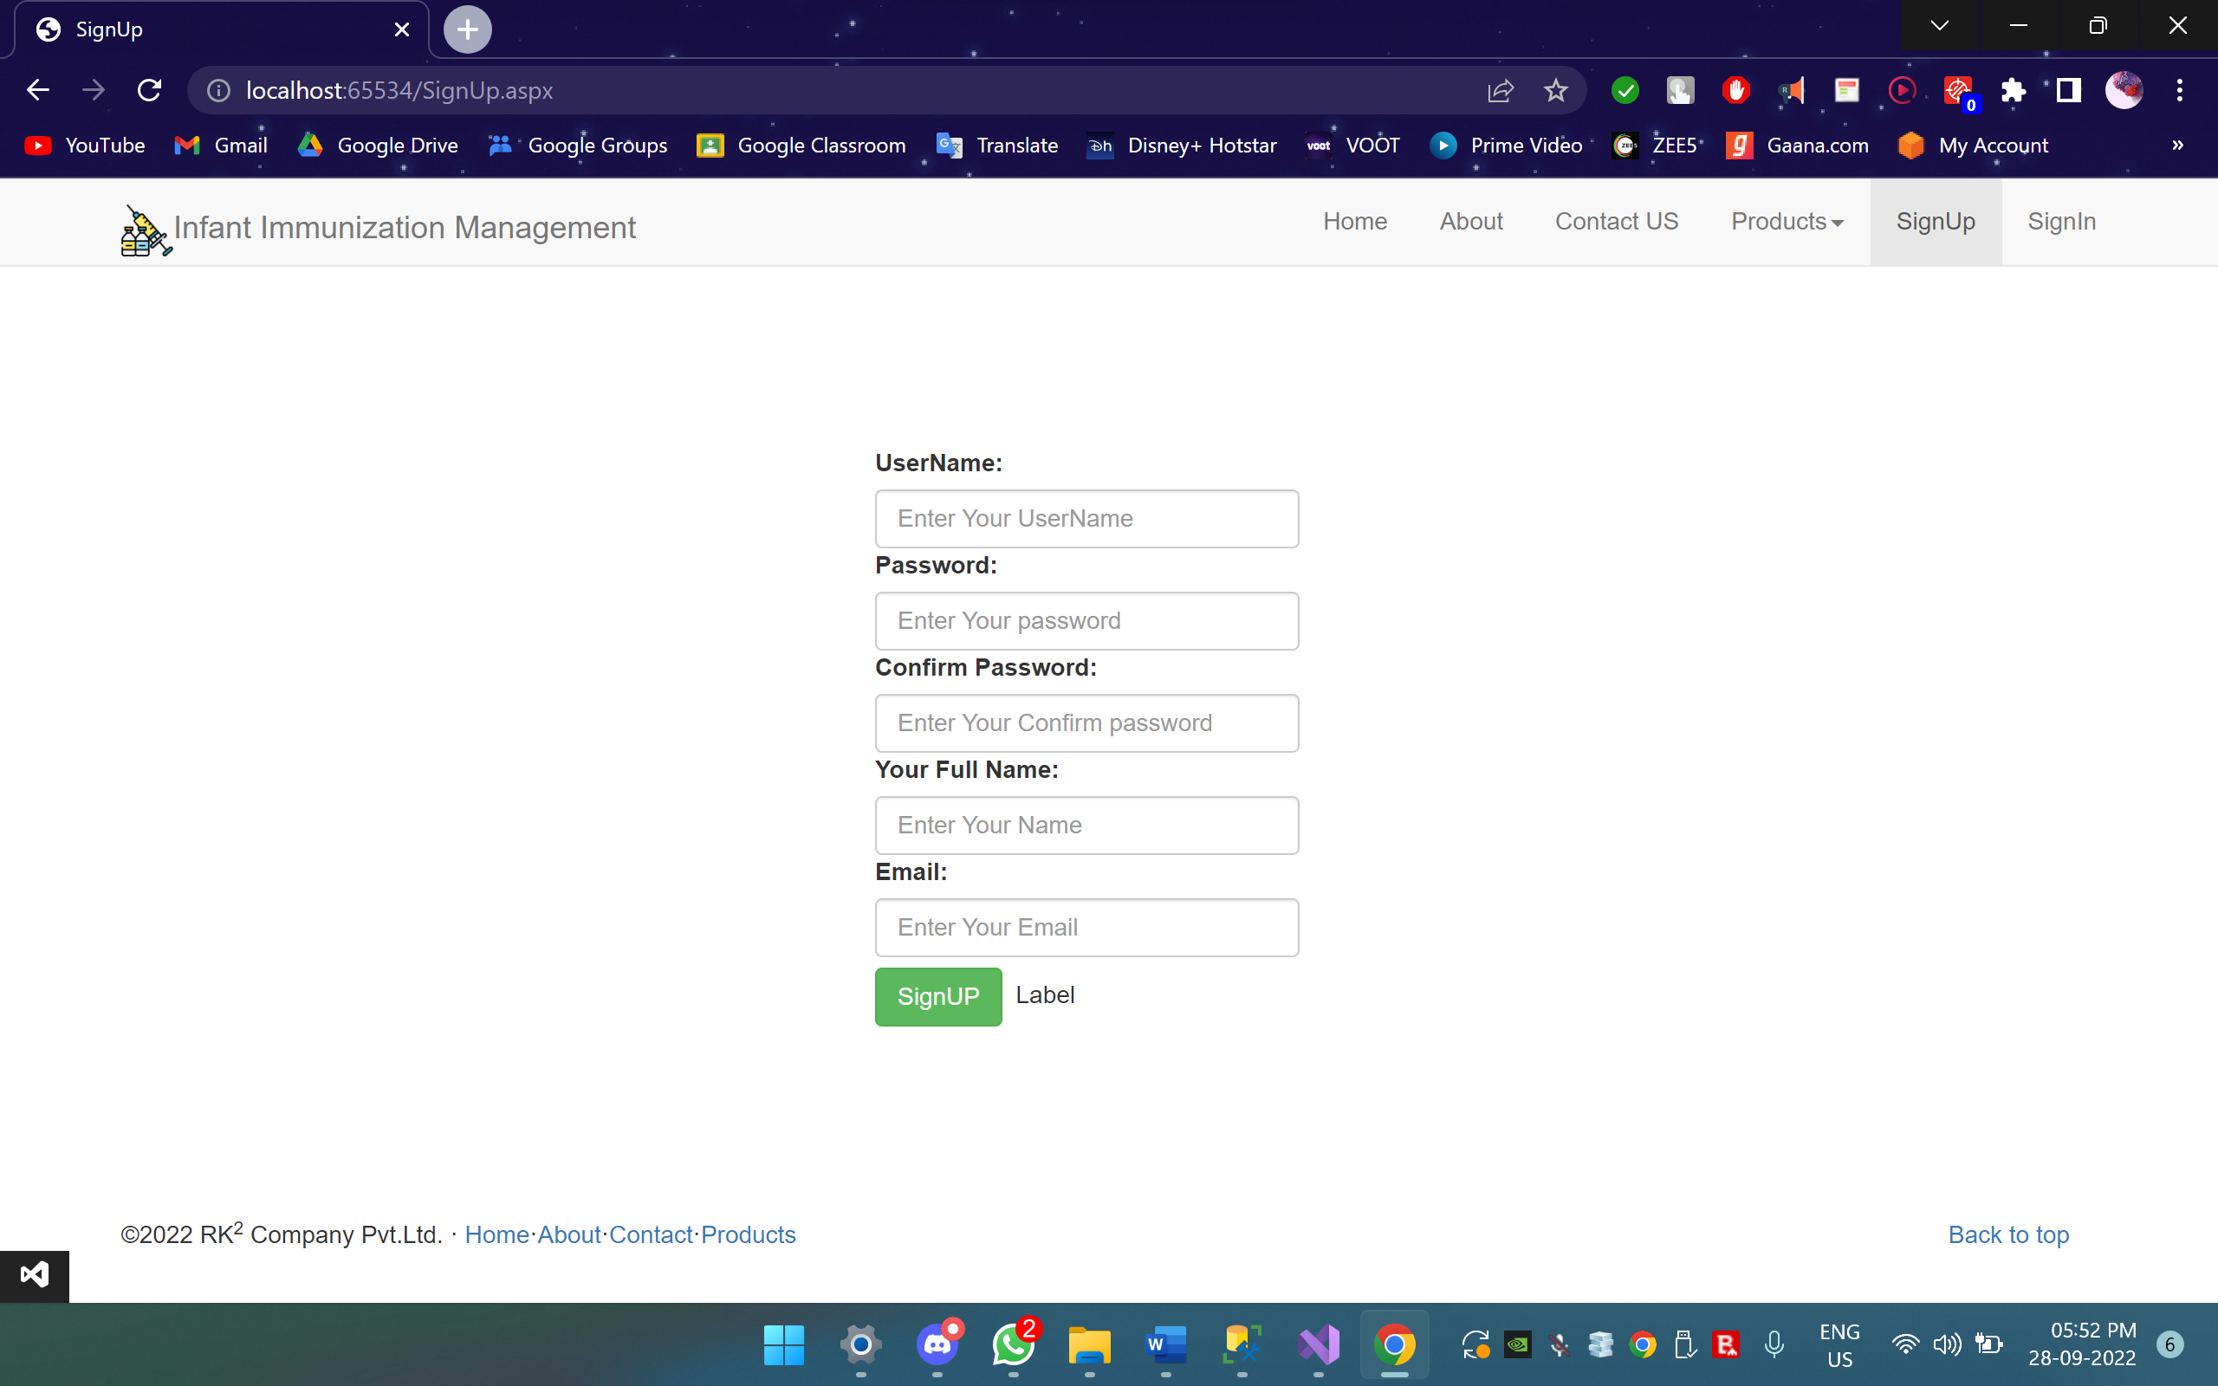

Slide 17
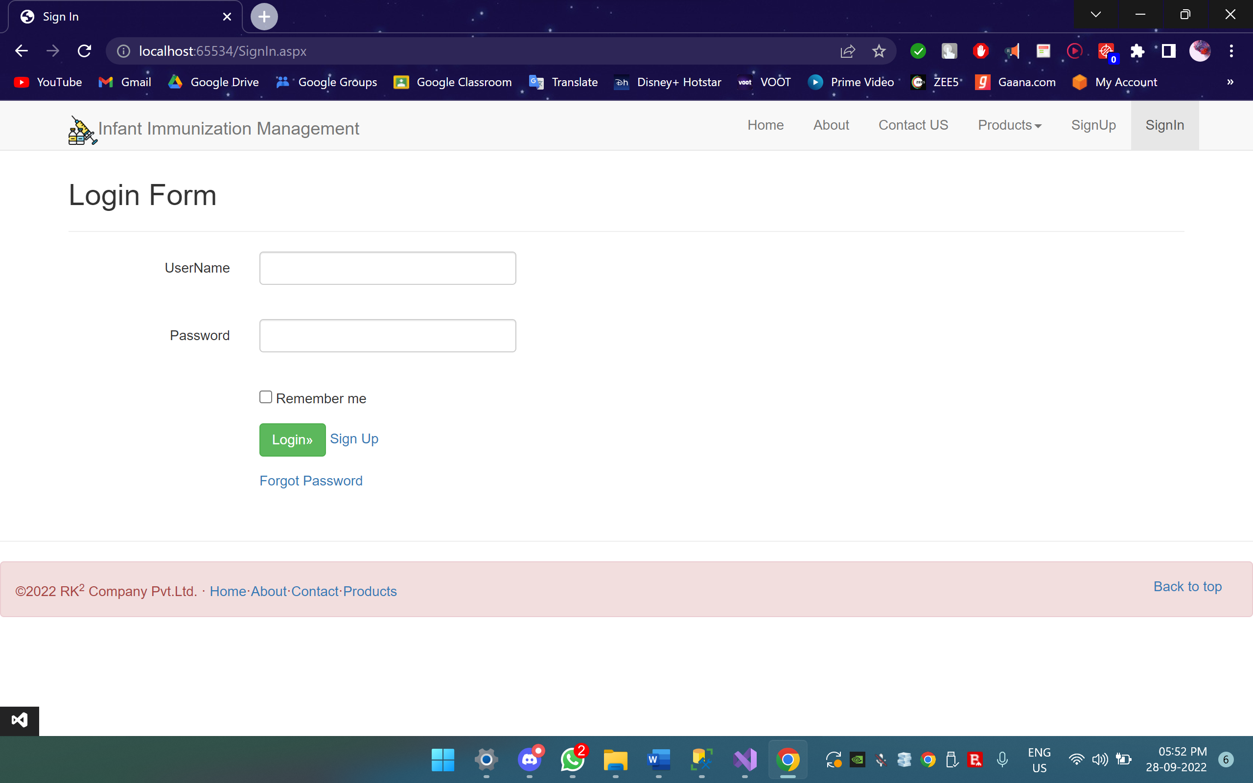

Slide 18
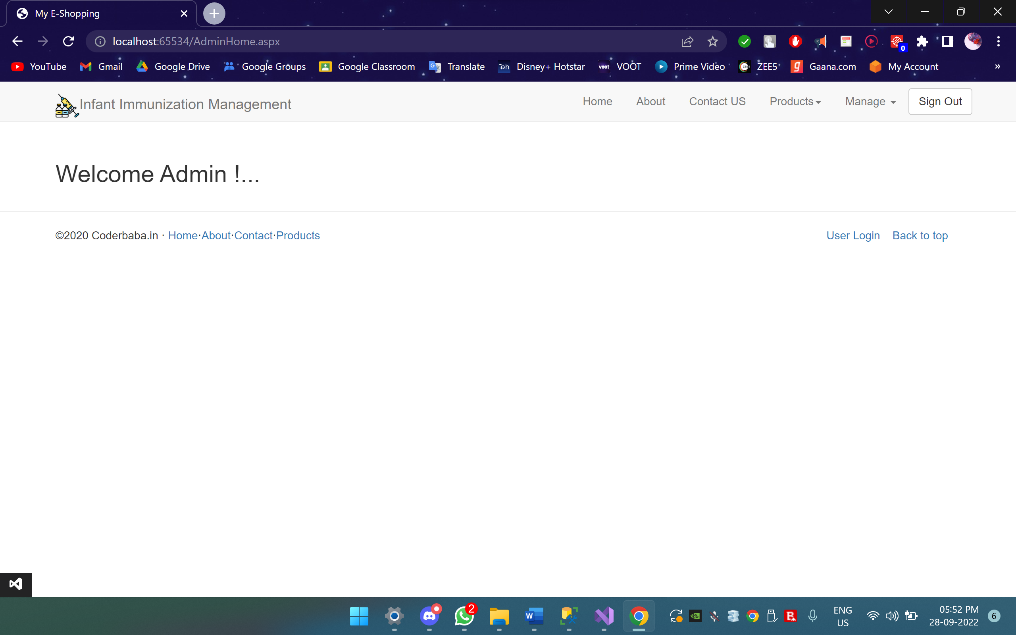

Slide 19
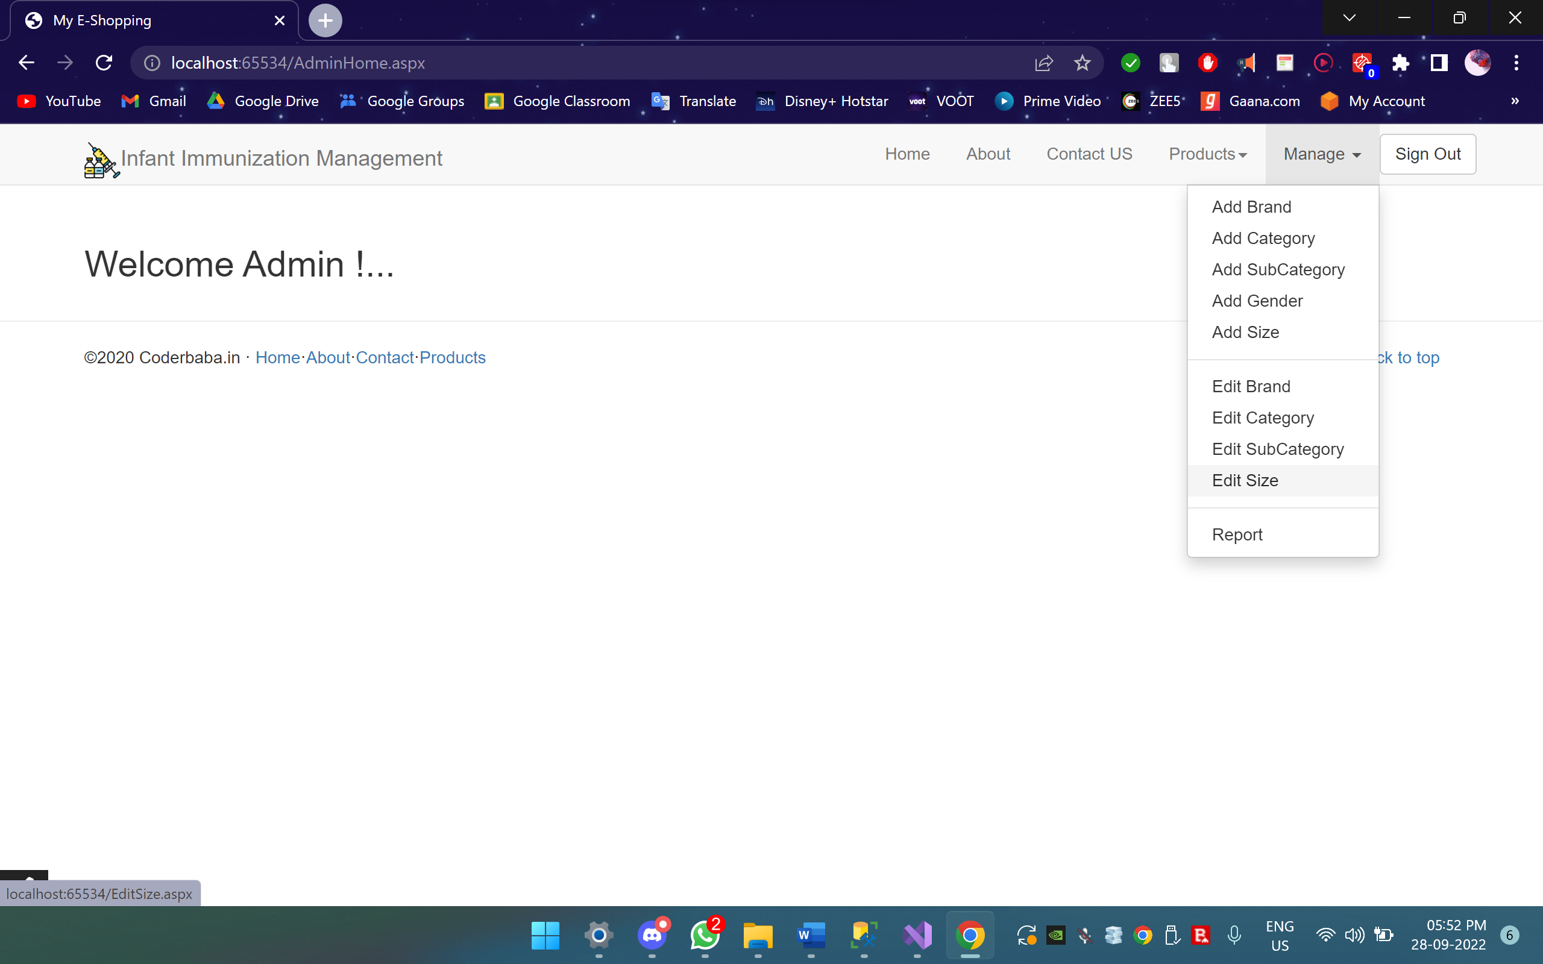

Slide 20
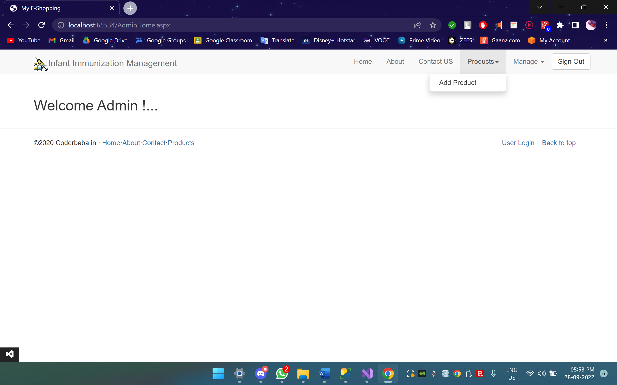

Slide 21
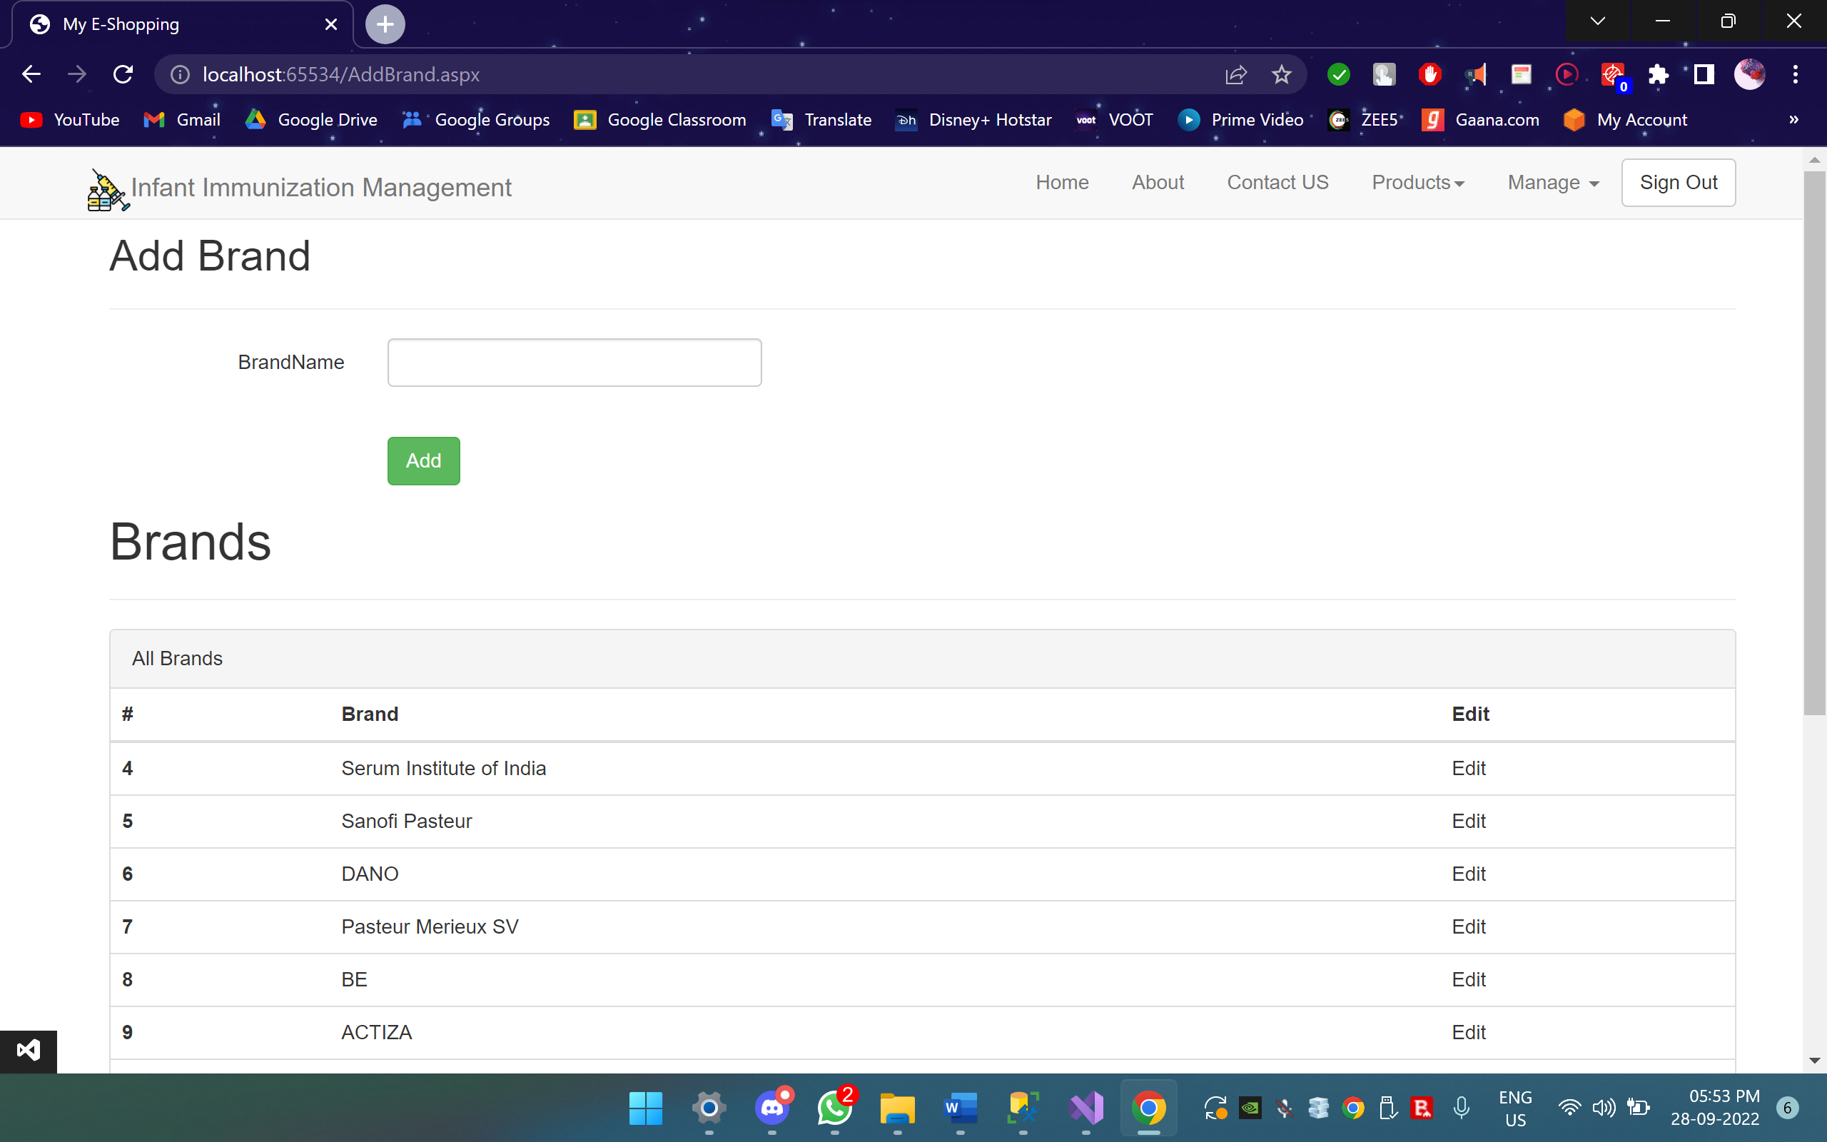

Slide 22
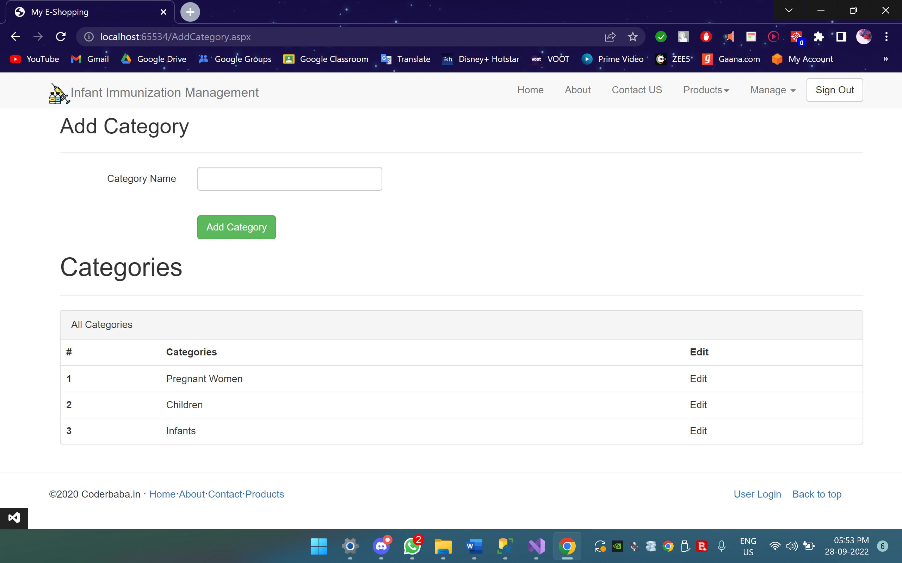

Slide 23
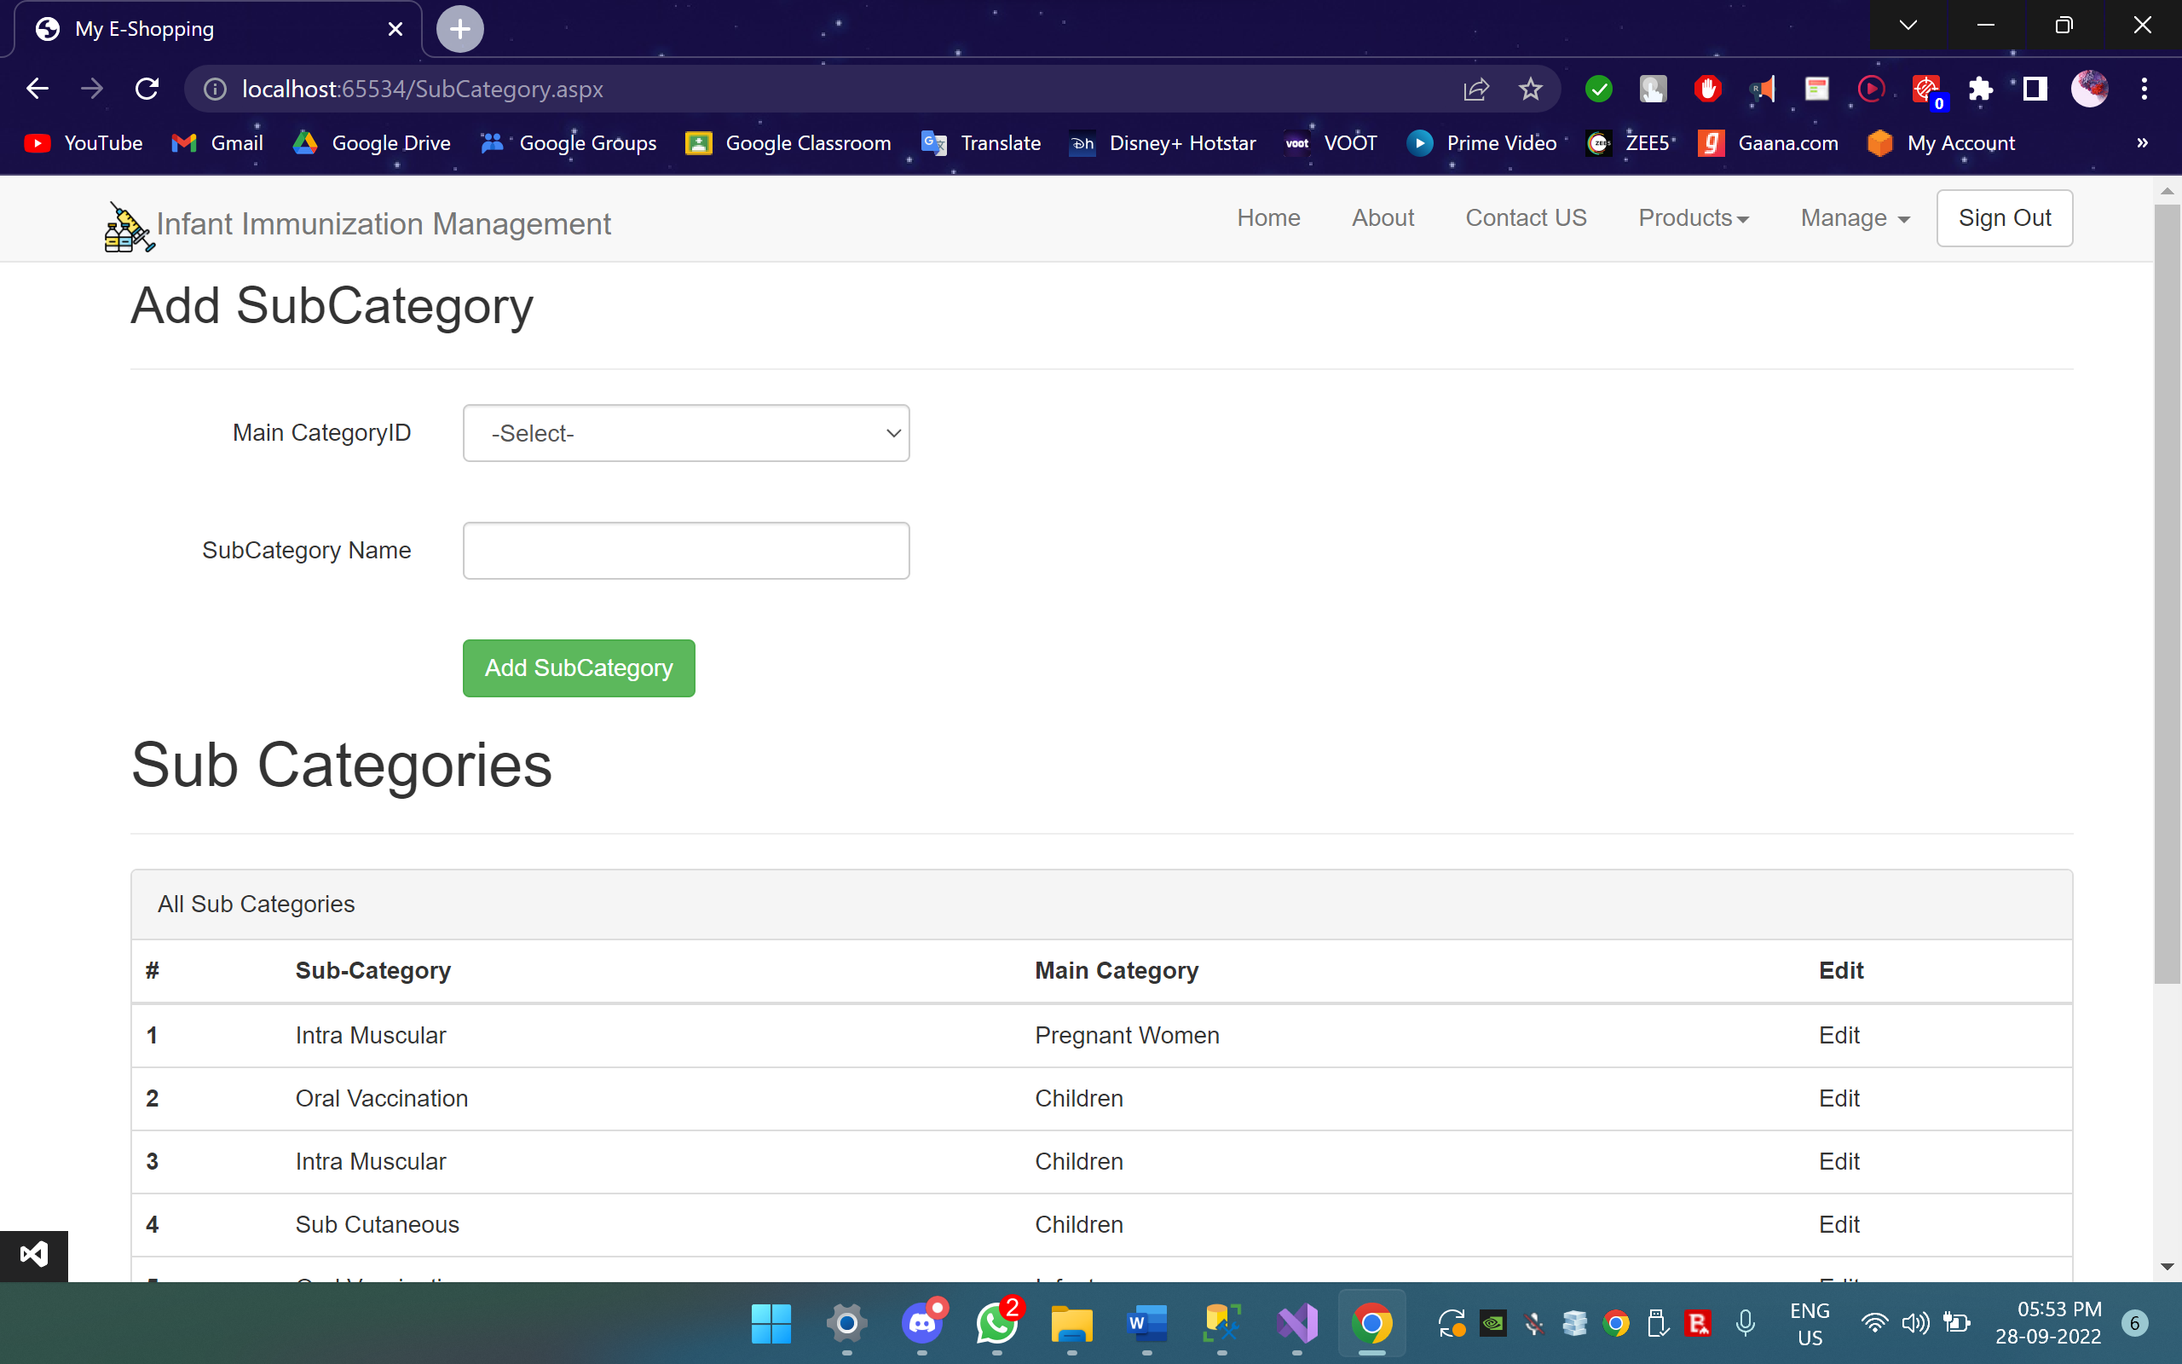

Slide 24
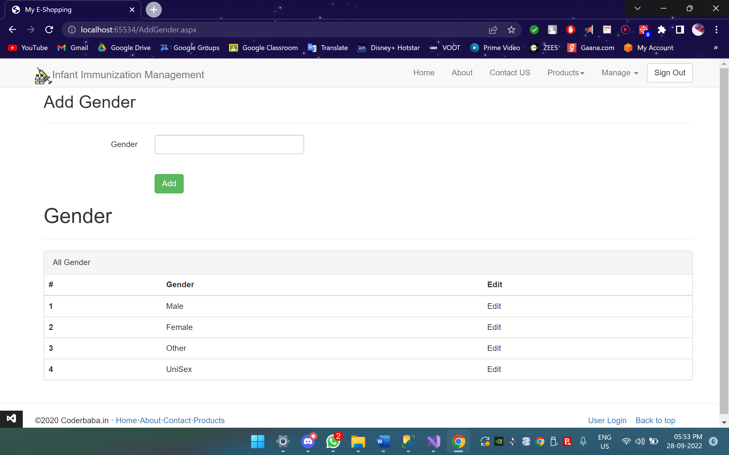

Slide 25
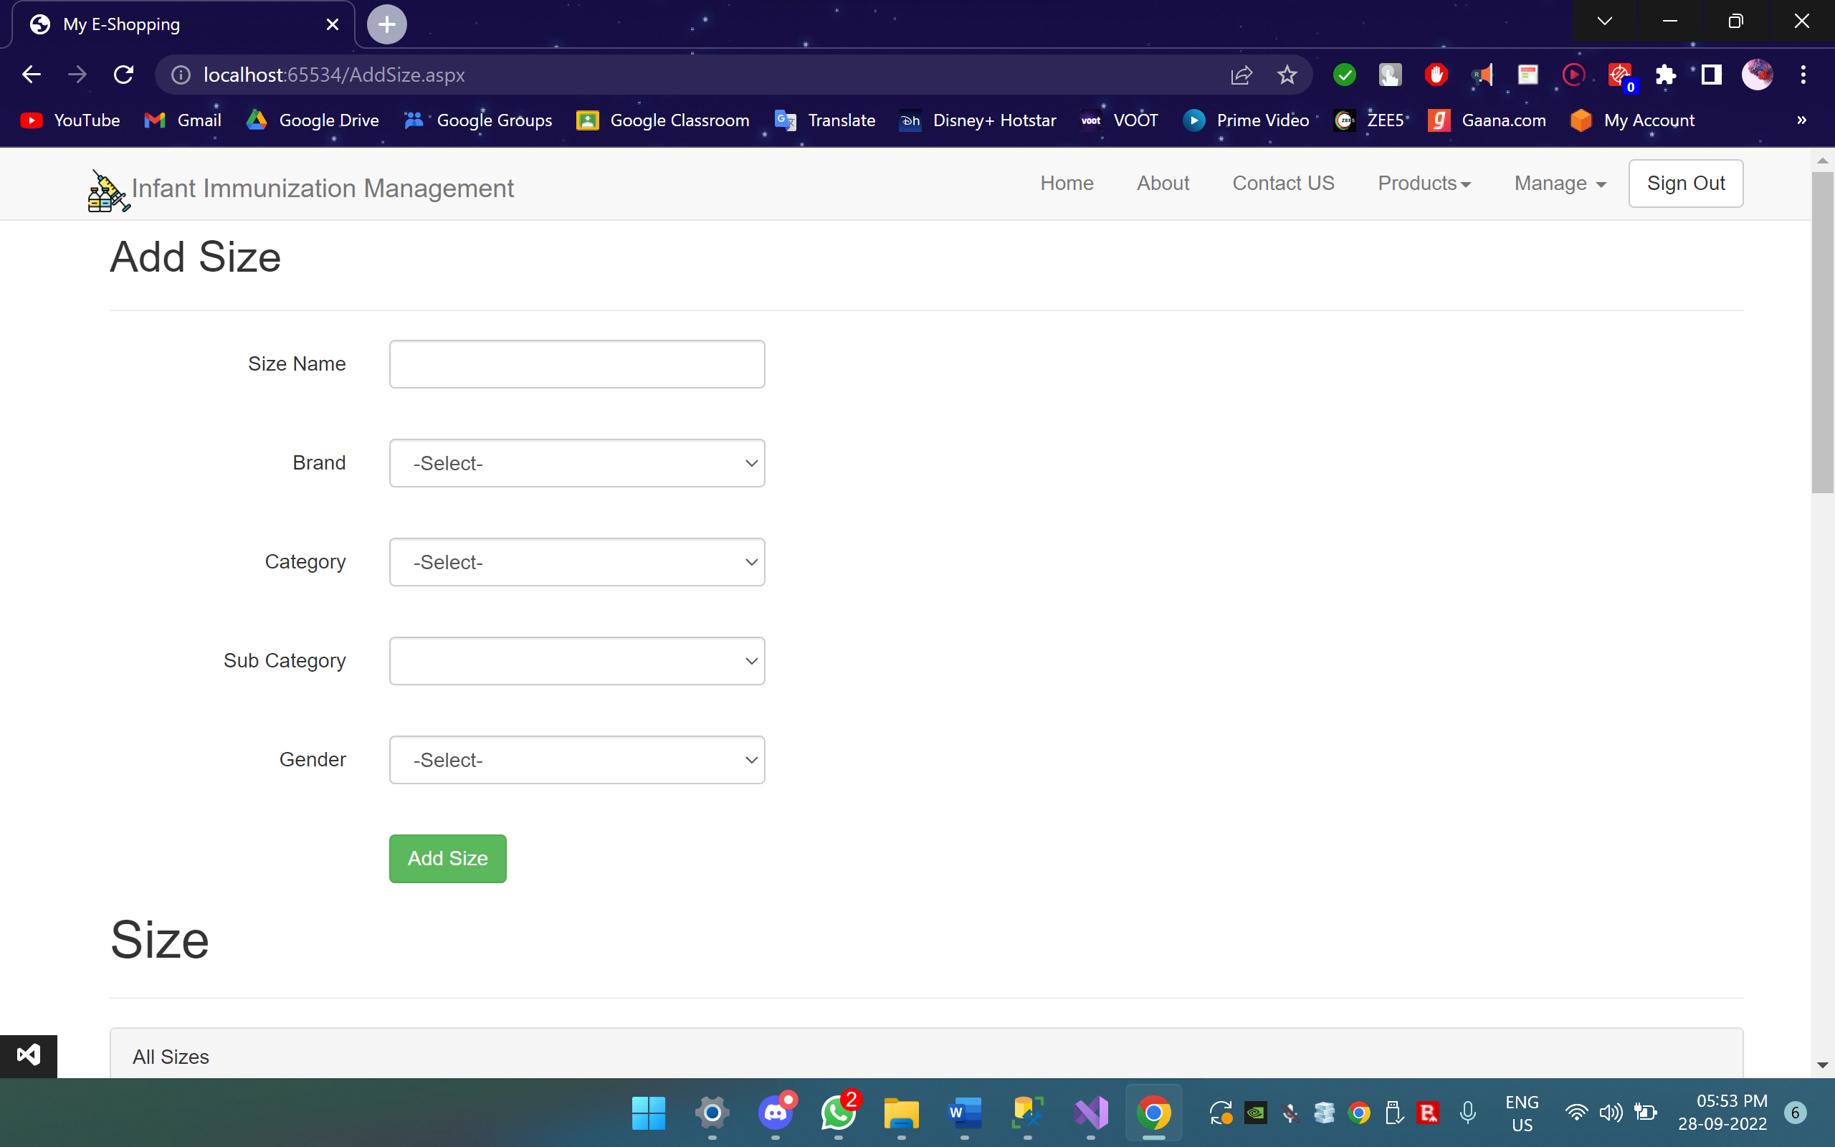

Slide 26
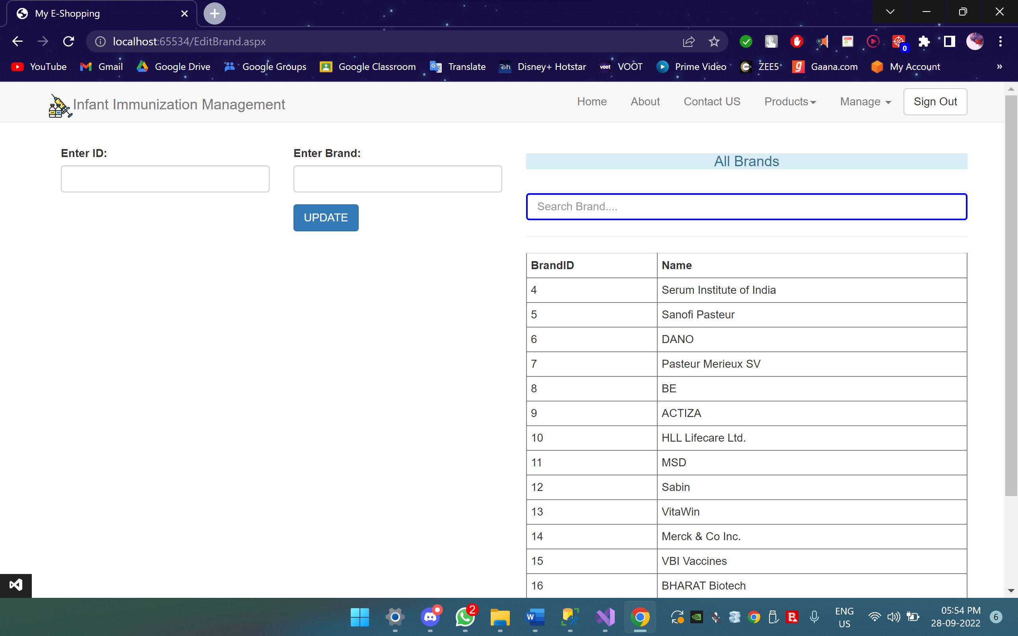

Slide 27
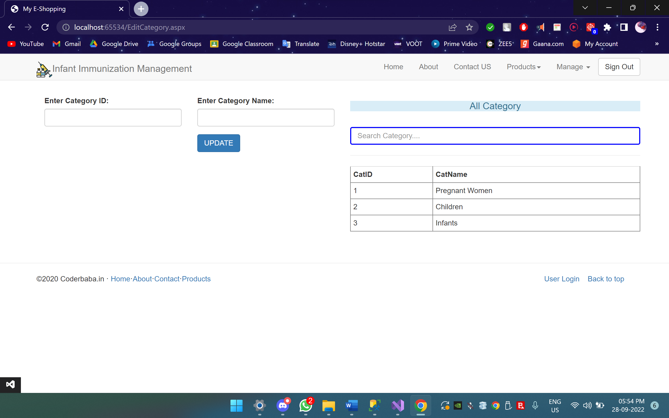

Slide 28
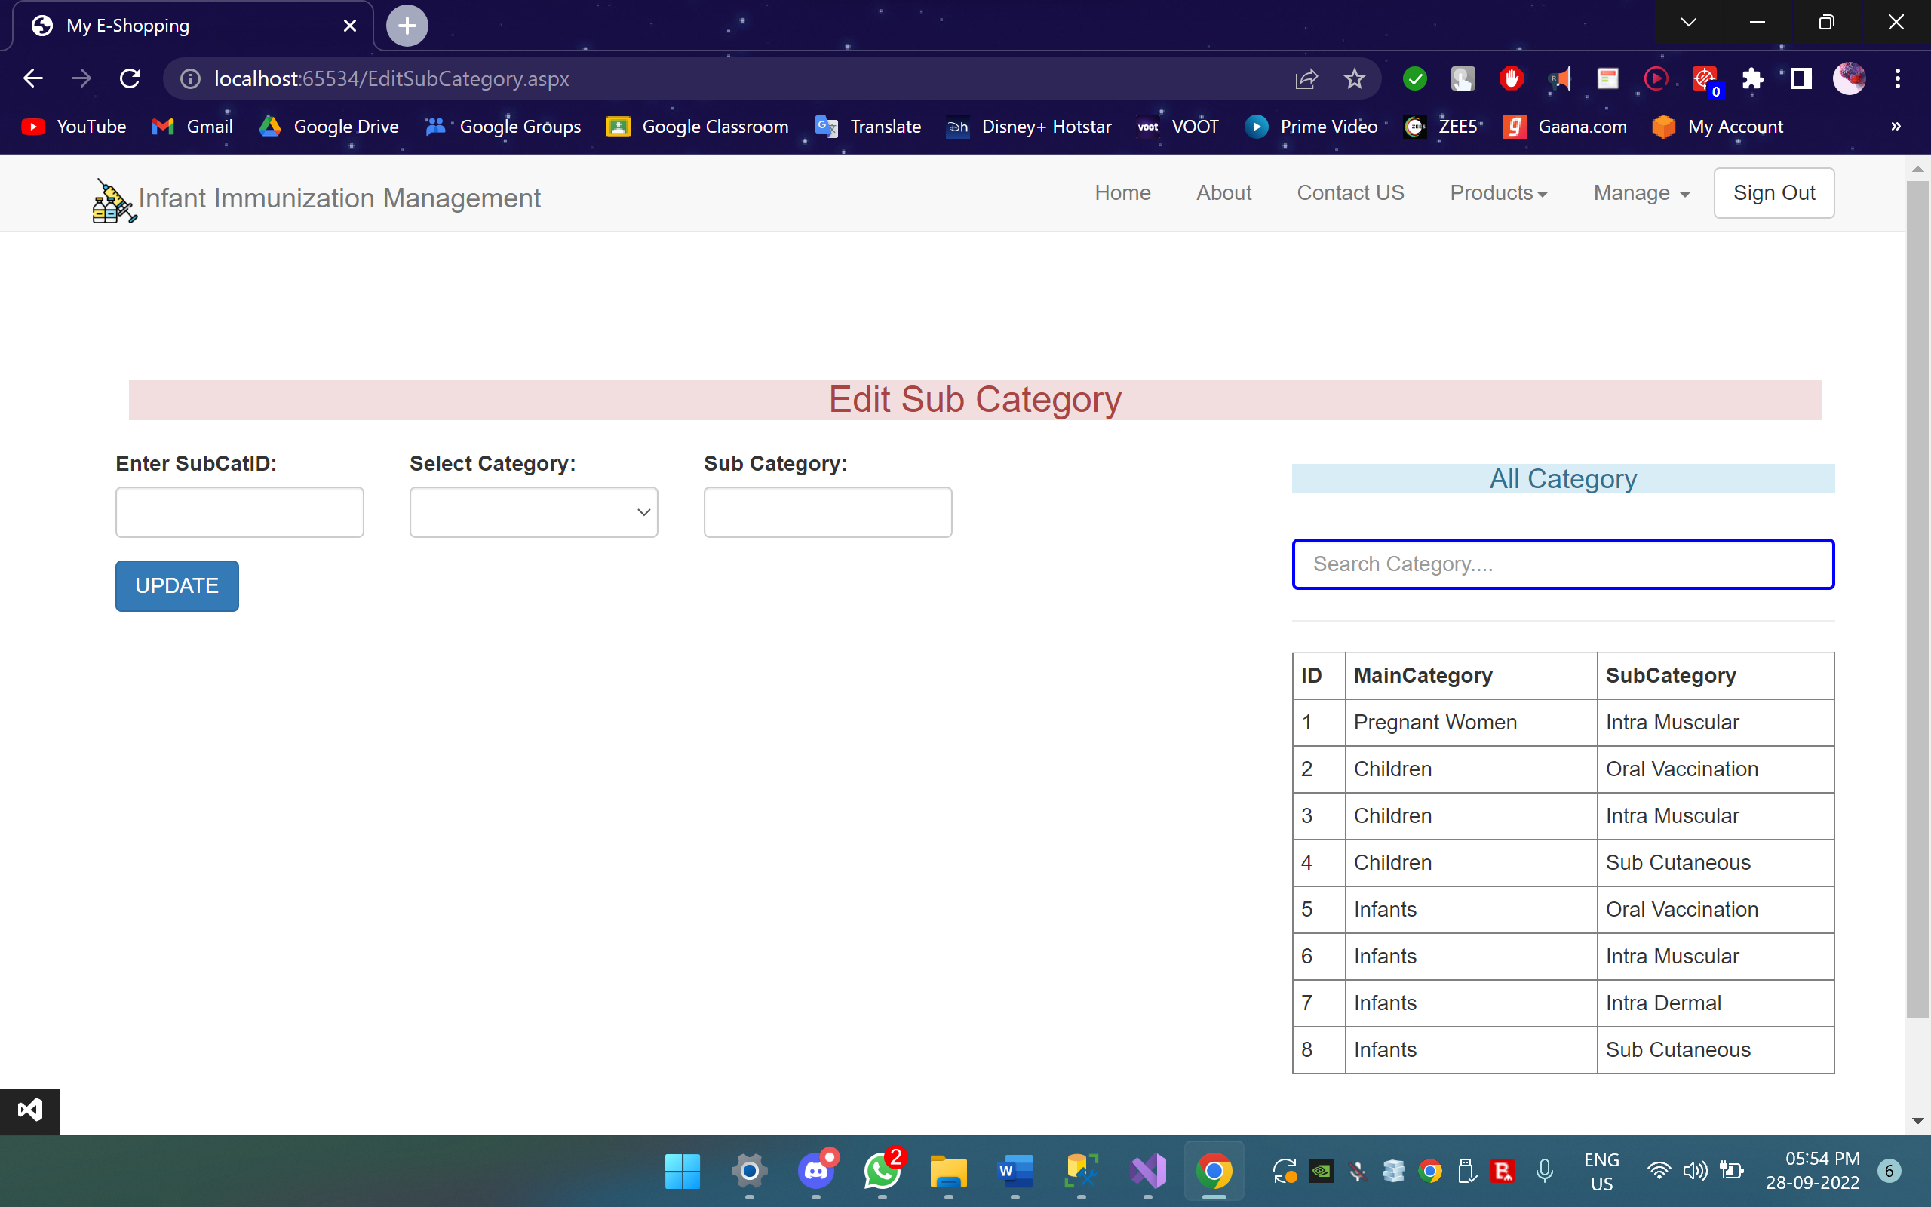

Slide 29
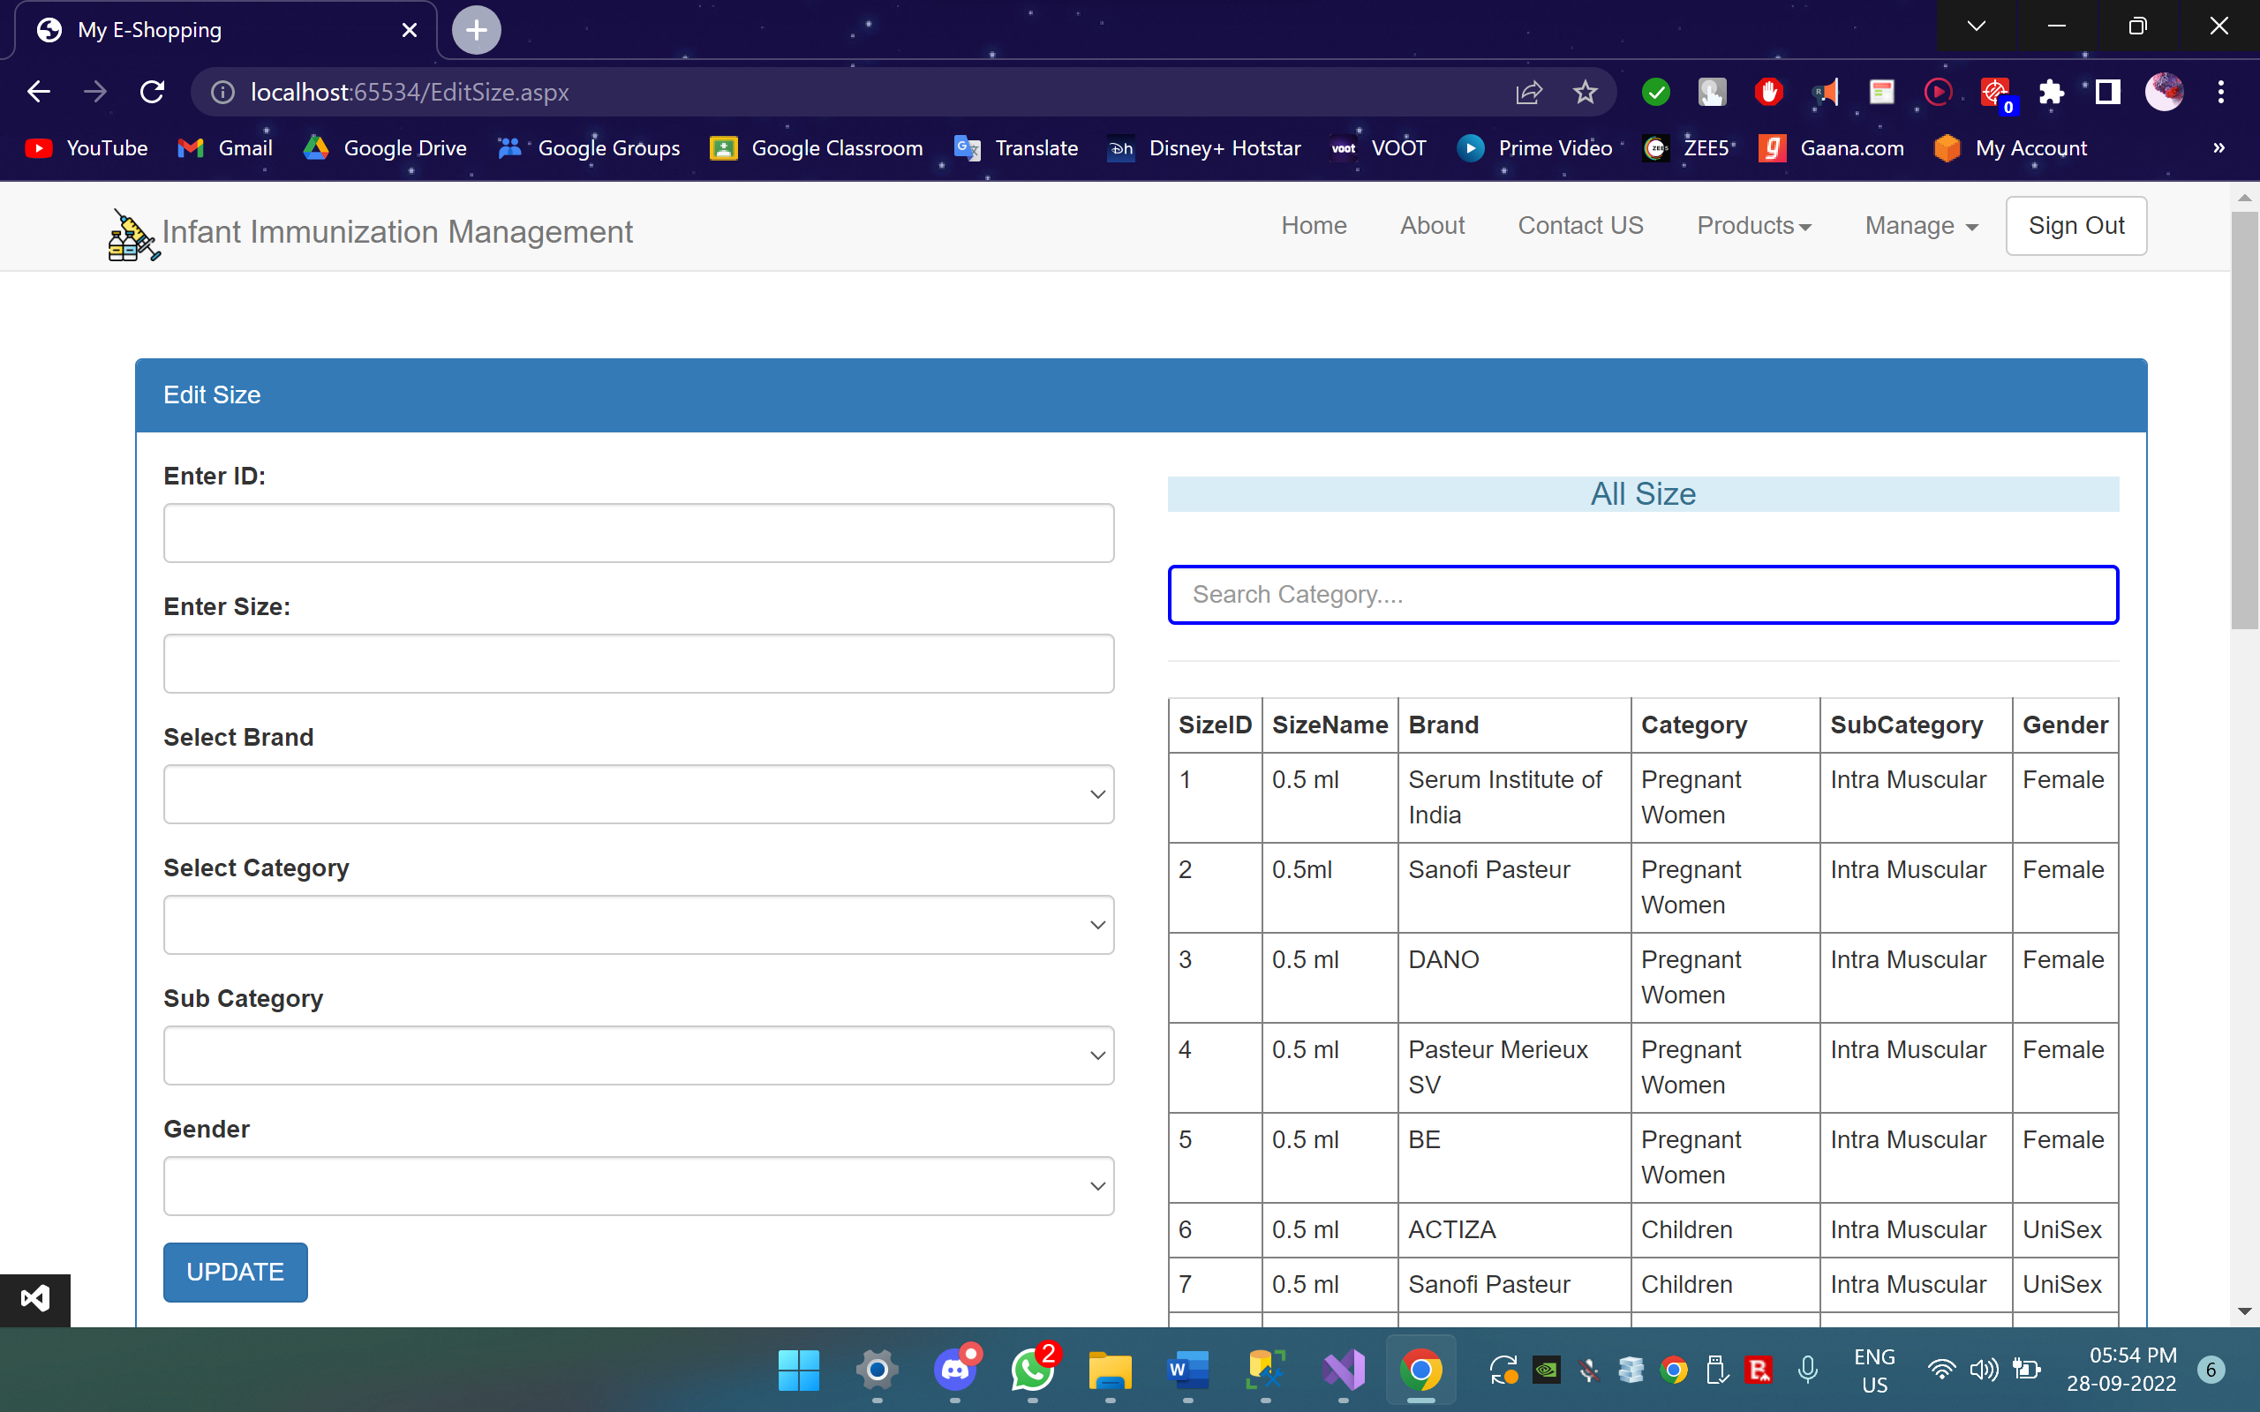

Slide 30
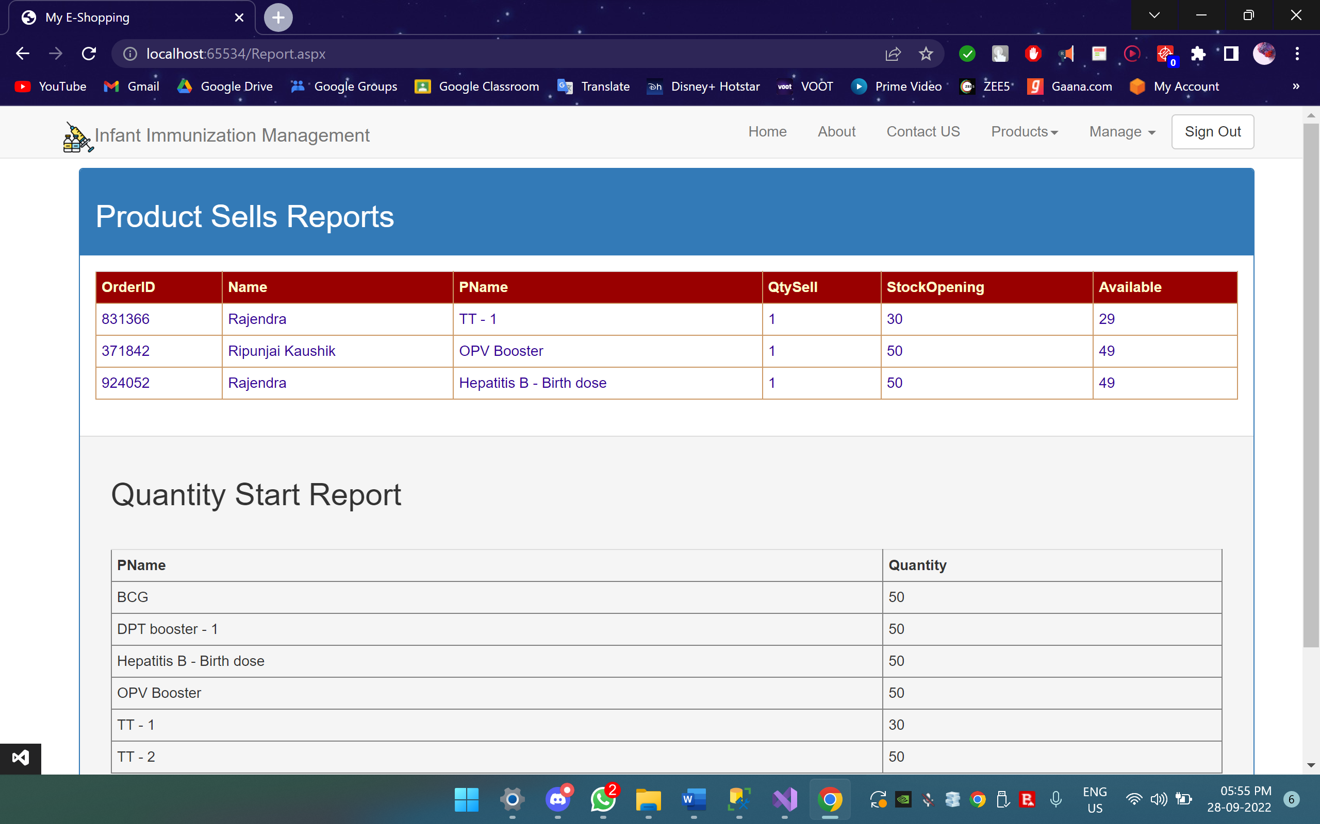

Slide 31
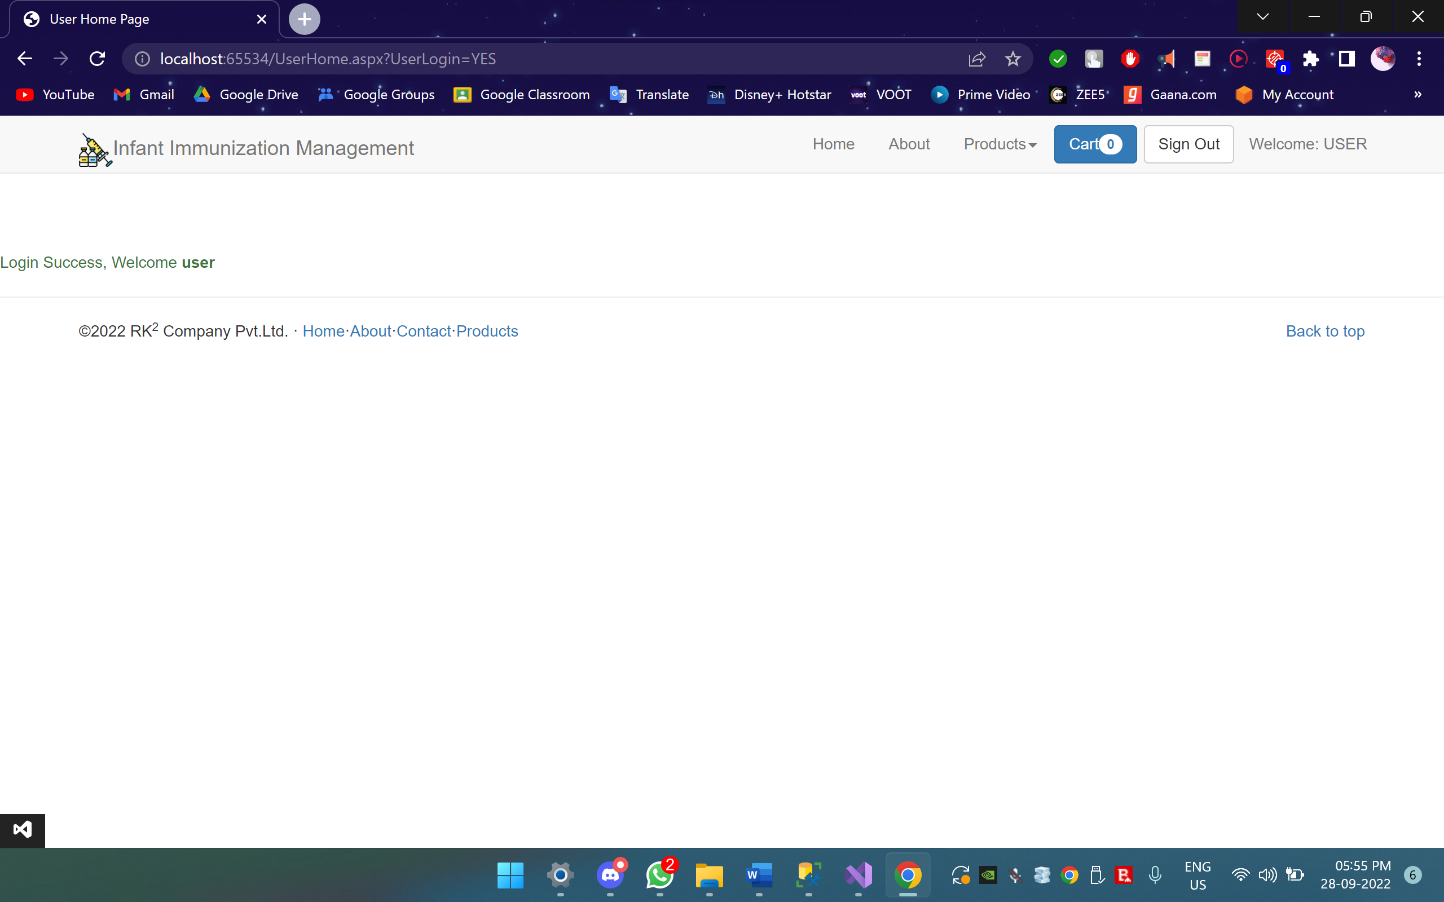

Slide 32
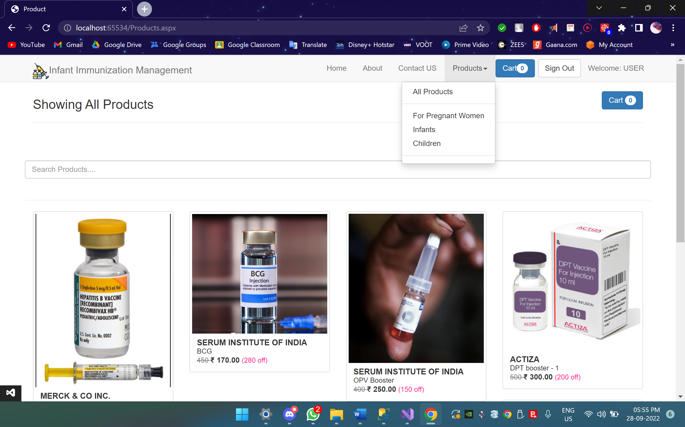

Slide 33
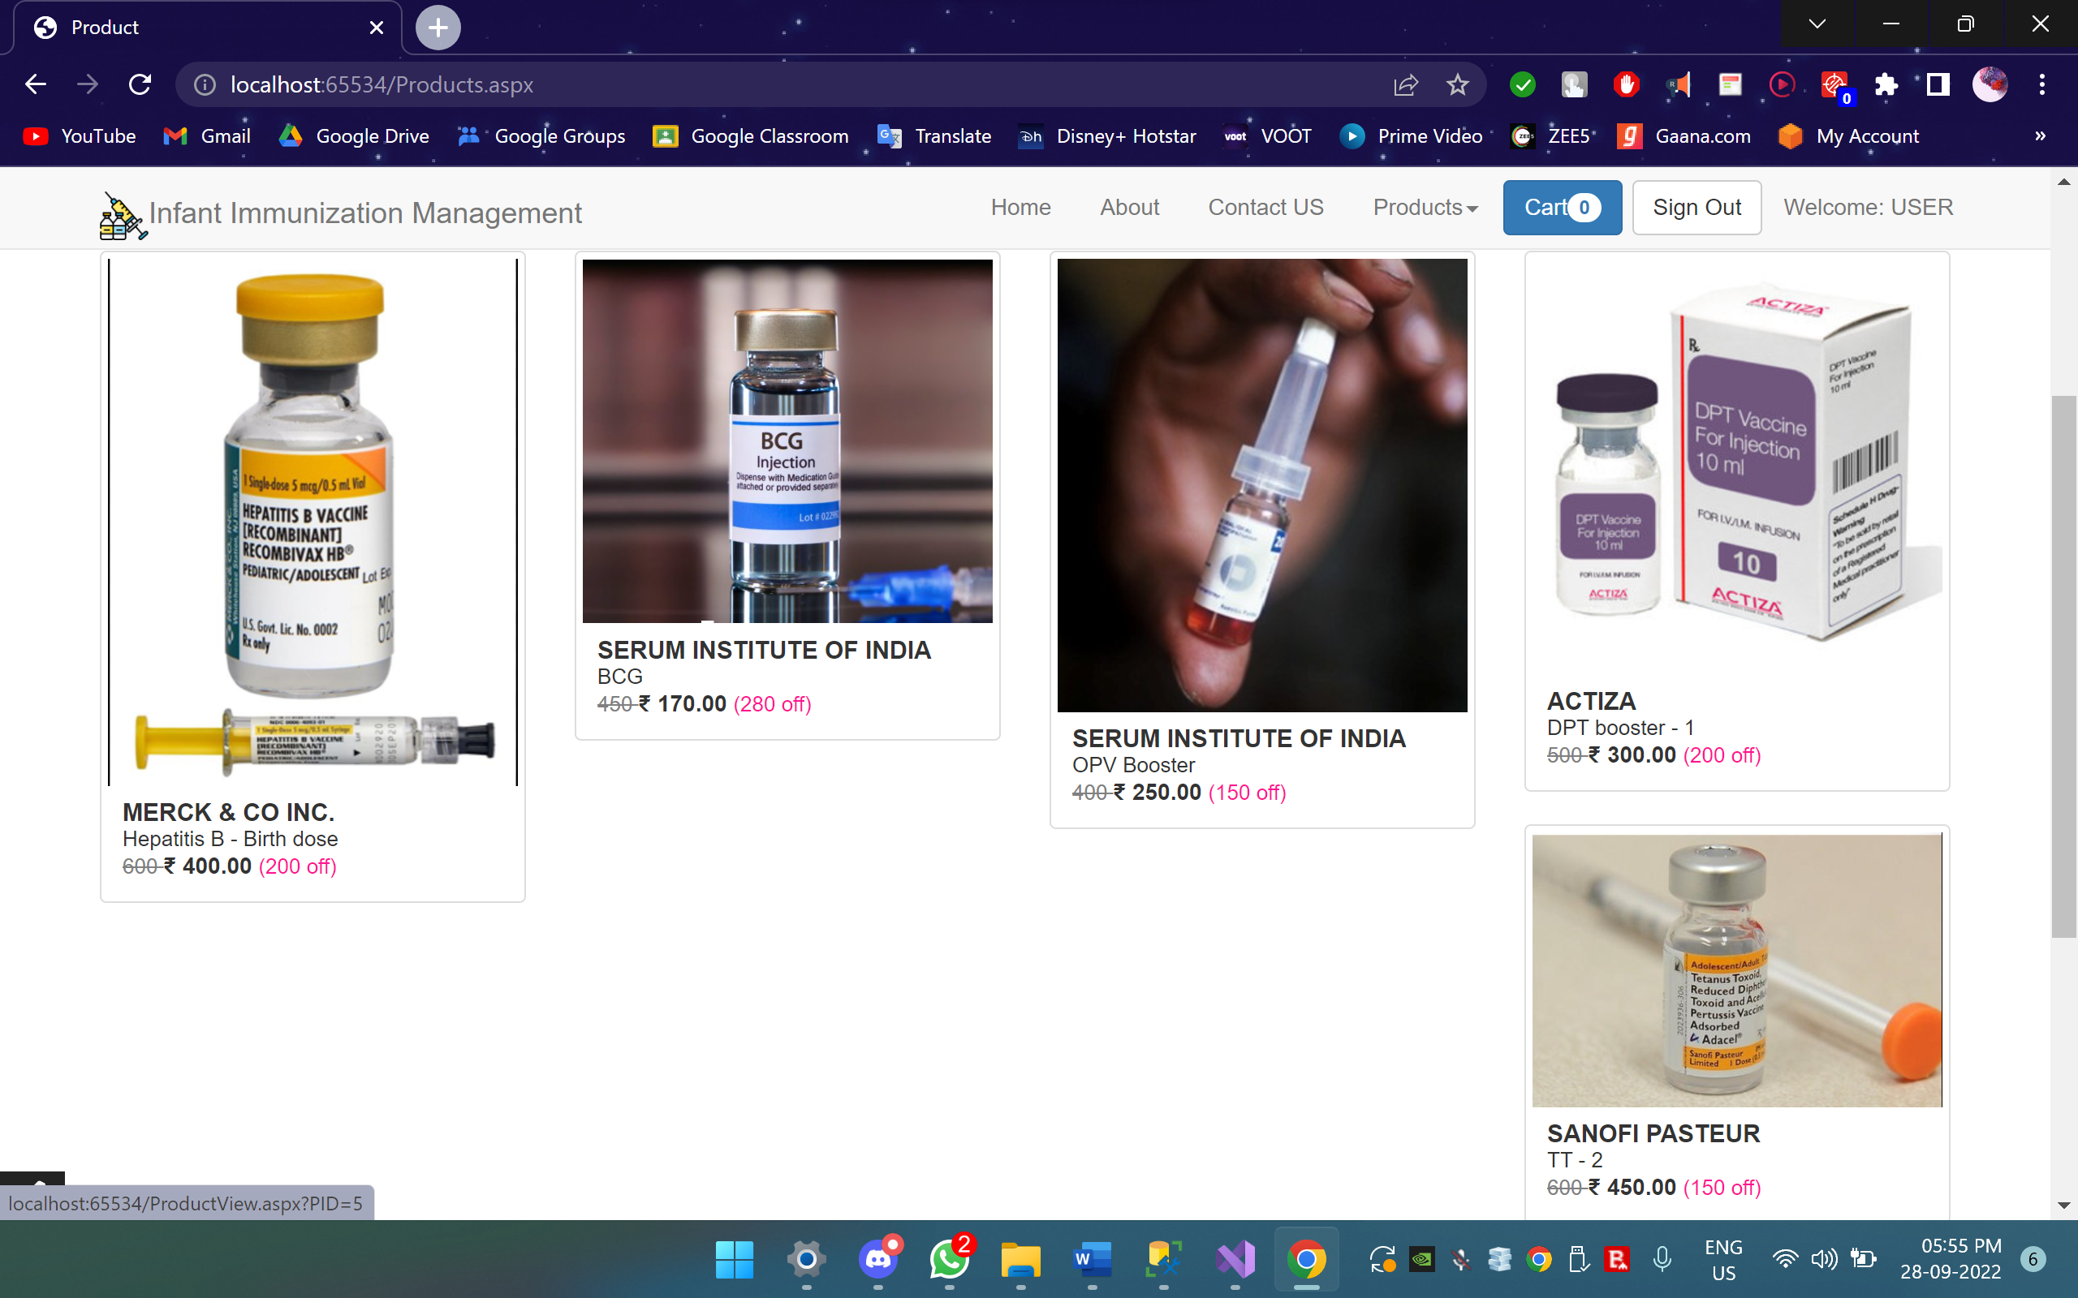

Slide 34
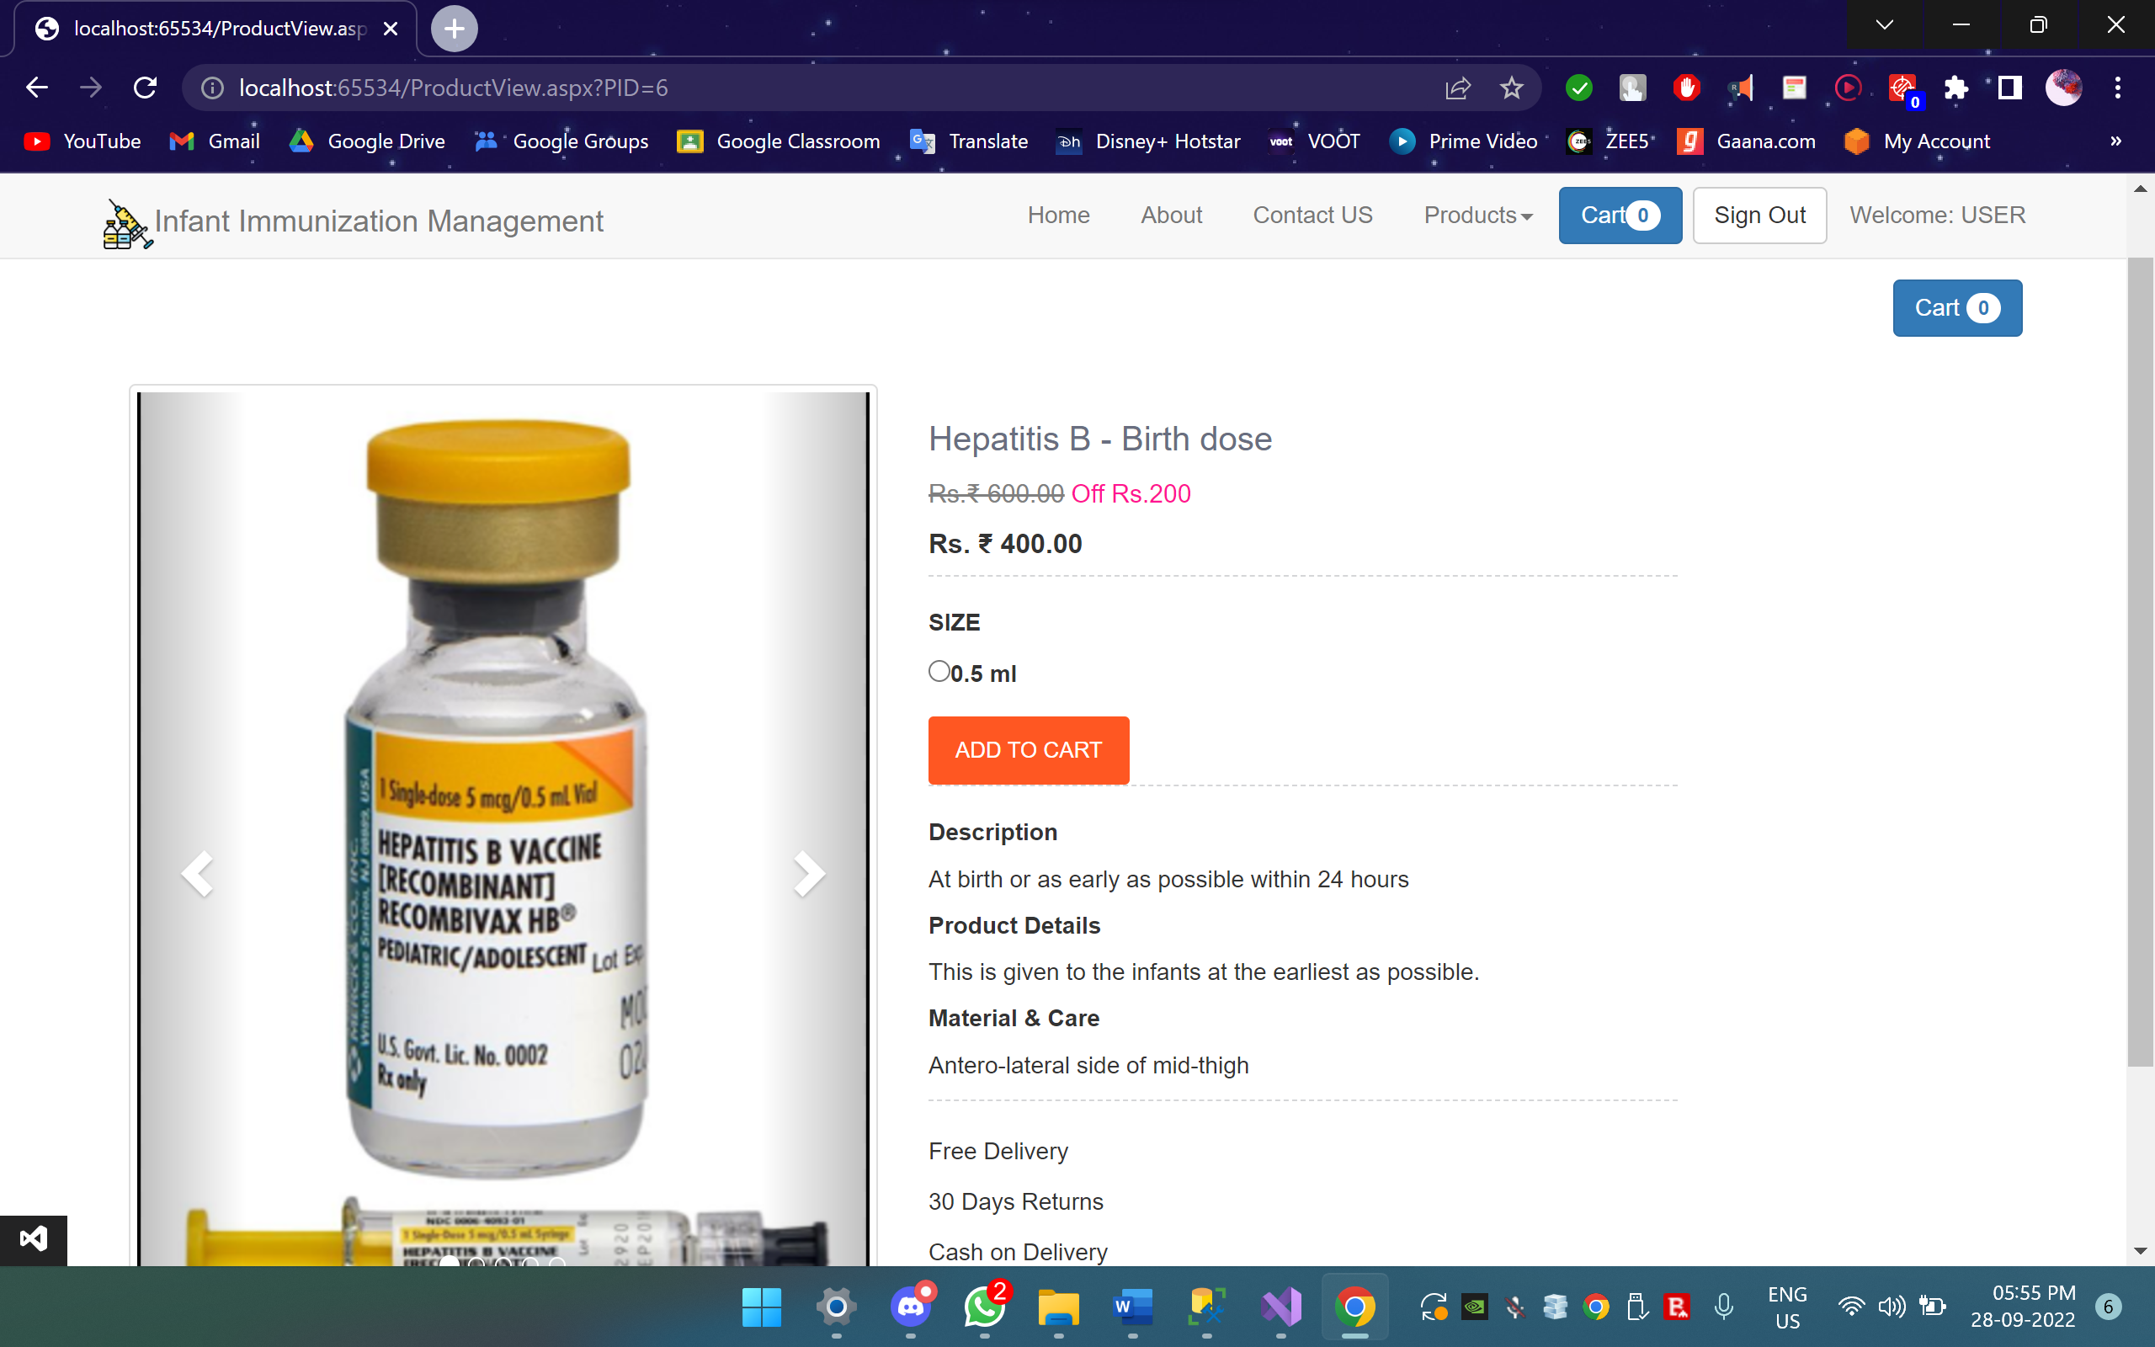

Slide 35
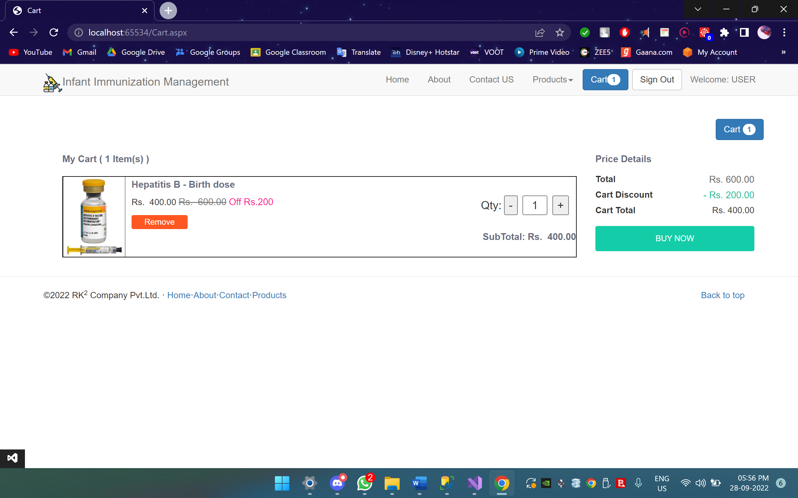

Slide 36
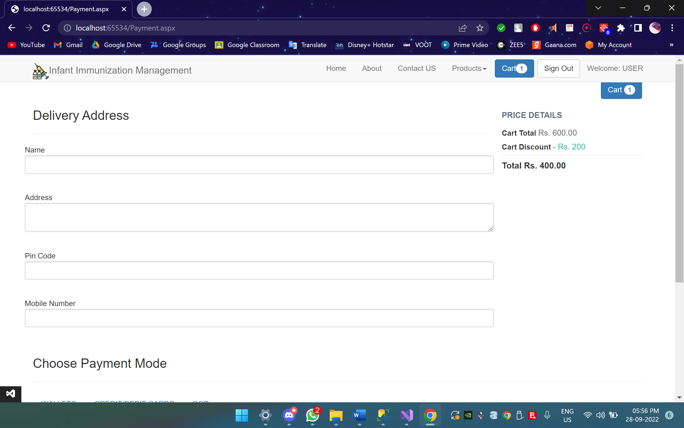

Slide 37
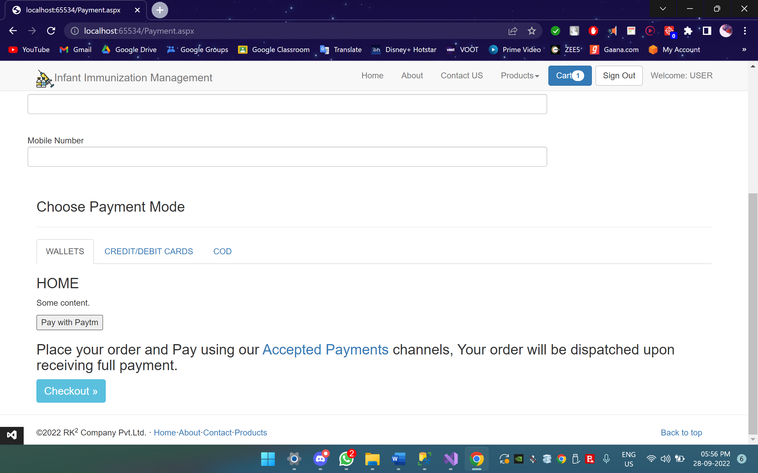

Slide 38
